Slide 1
CIS 565 CUDA Performance Lab Profiling
Shehzan Mohammed
@shehzanm

Slide 2
Today’s List
Nsight Profiler
NVIDIA Visual Profiler(NVVP)
NVVP and nvprof have been deprecated as of CUDA 10

Slide 3
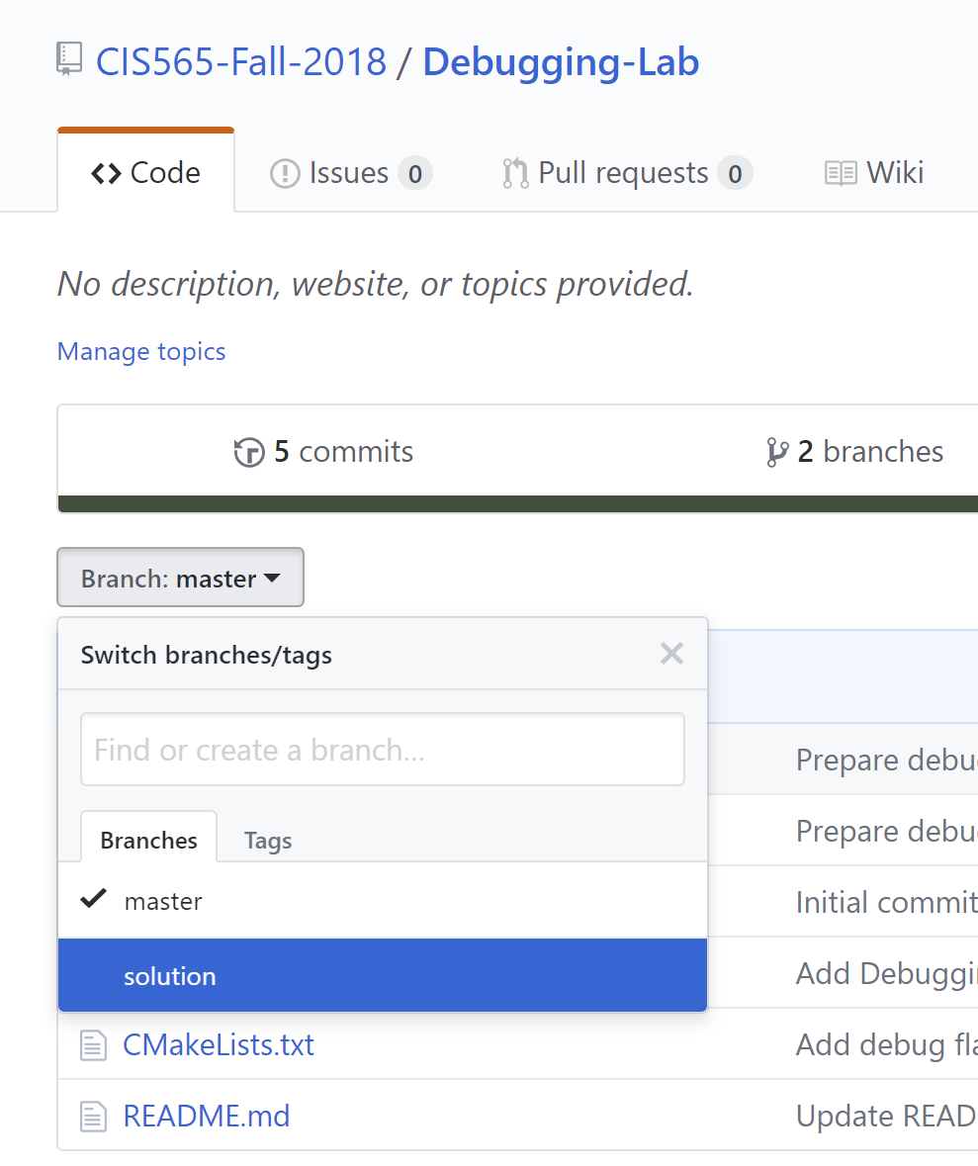
Performance Lab Starter Code
If you completed the transpose kernels – Awesome!
If you did not, no problem – but ask questions if you have.
How many checked the solution branch in Debugging Lab?
Either way, pull the latest master.
It is updated with the Transpose kernels solutions.

Slide 4
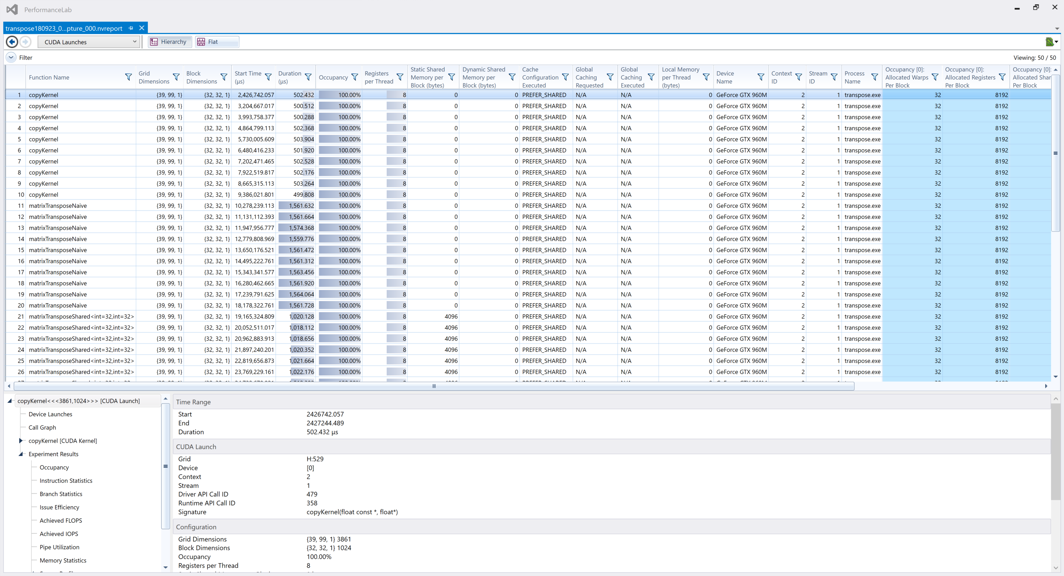
Nsight Profiler
https://docs.nvidia.com/nsight-visual-studio-edition/Nsight_Visual_Studio_Edition_User_Guide.htm#Analysis_Tools_Overview.htm%3FTocPath%3DAnalysis%2520Tools%7C_____0

Slide 5
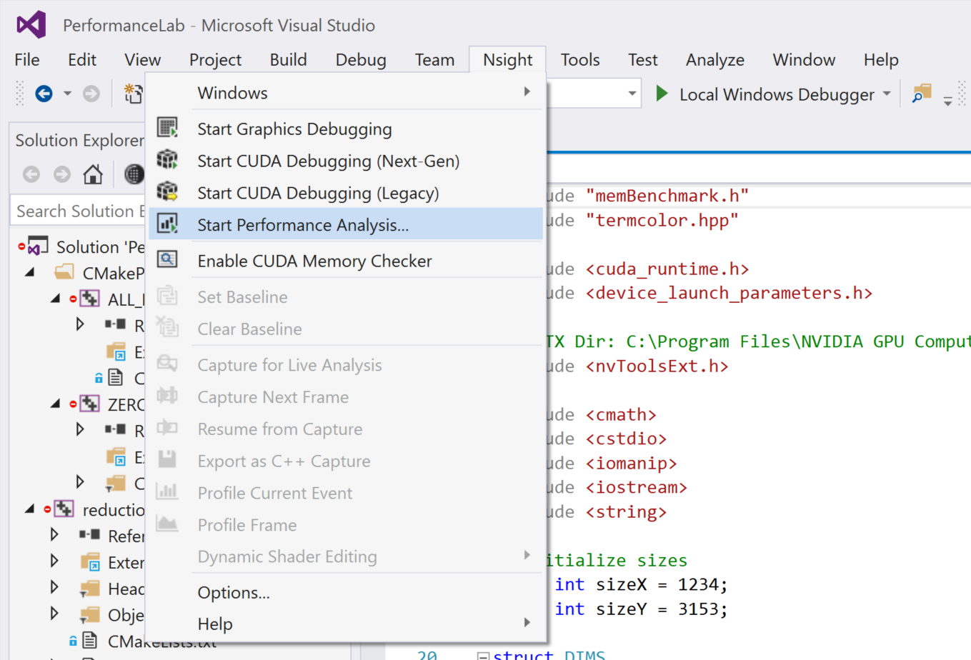
Running Nsight Profiler
Nsight -> Start Performance Analysis

Slide 6
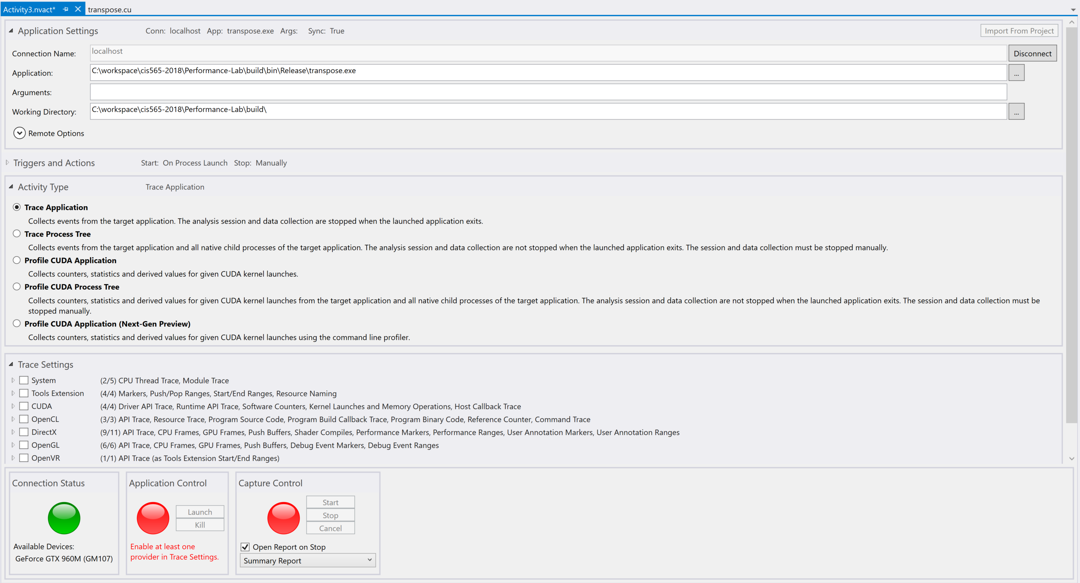
https://docs.nvidia.com/nsight-visual-studio-edition/5.6/Nsight_Visual_Studio_Edition_User_Guide.htm#Activity_Document.htm%3FTocPath%3DAnalysis%2520Tools%7C_____1

Slide 7
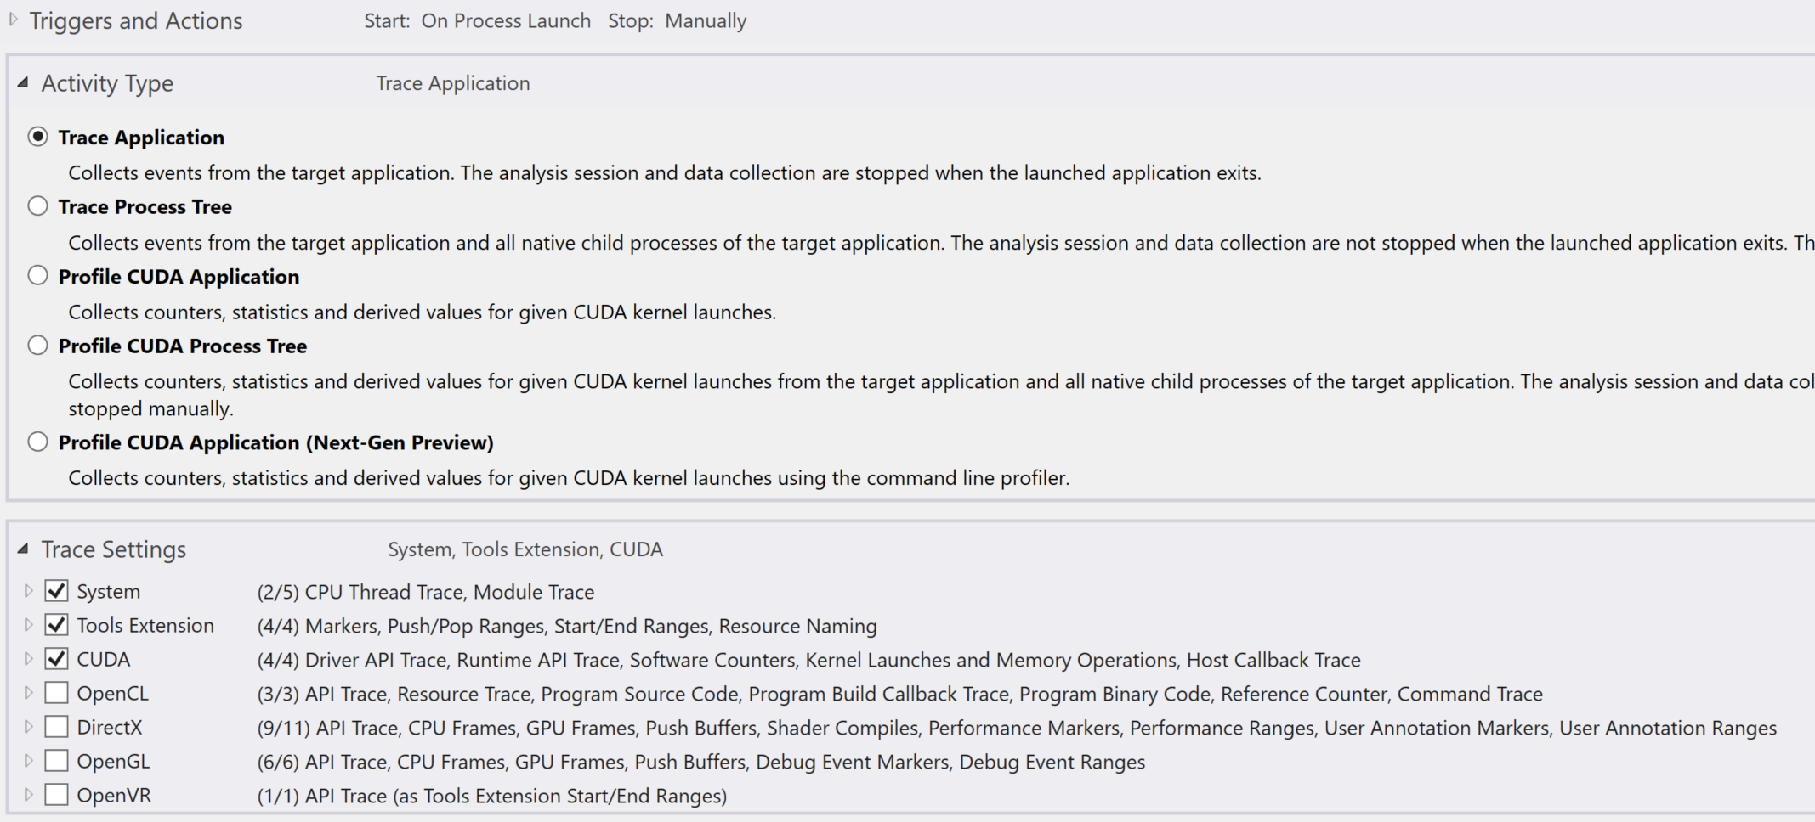
Let’s start with Trace Application
Select System, Tools Extension, CUDA in Trace Settings
https://docs.nvidia.com/nsight-visual-studio-edition/5.6/Nsight_Visual_Studio_Edition_User_Guide.htm#Analysis_Trace_Settings.htm%3FTocPath%3DAnalysis%2520Tools%7C_____3
Notes:
System: CPU functions etc
Tools Extensions: Ranges, Names, events etc (used for performance timings)
CUDA: Driver, Runtime, Memory, Kernels etc

Slide 8
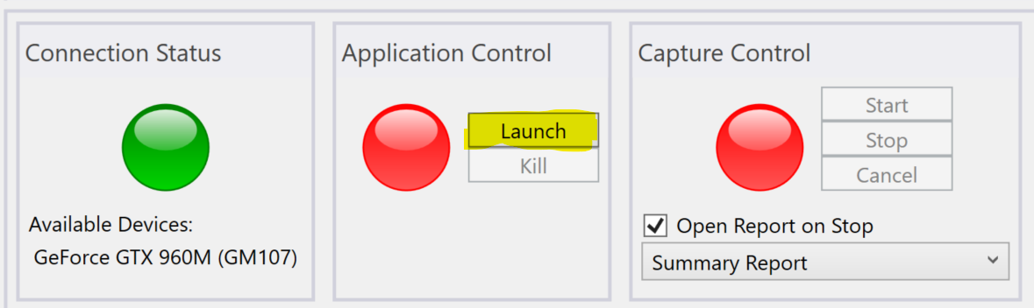
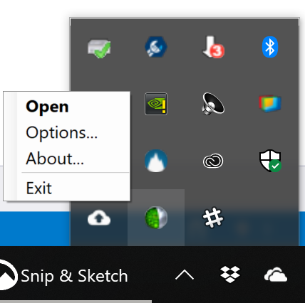
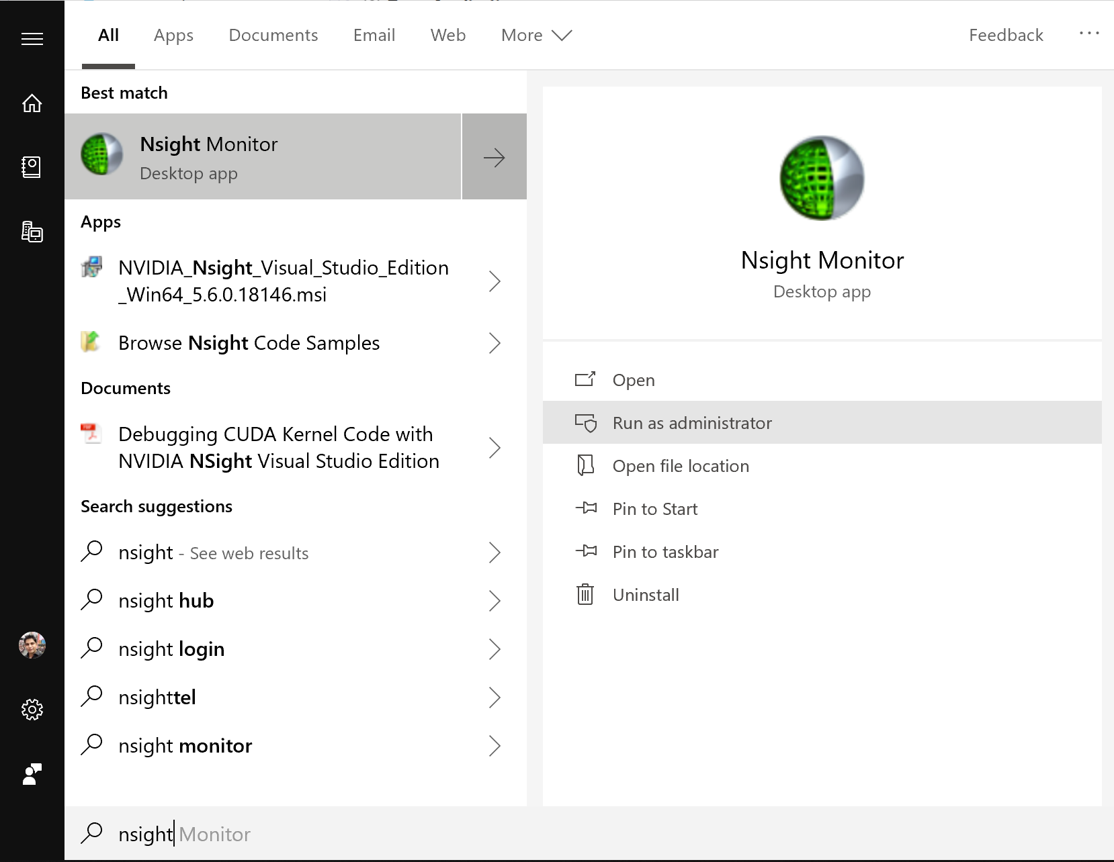
Let’s start with Trace Application
Click Launch
If you get “Trace with System requires elevated permissions…”
Exit Nsight Monitor from notification icon.
Then launch as administrator

Slide 9
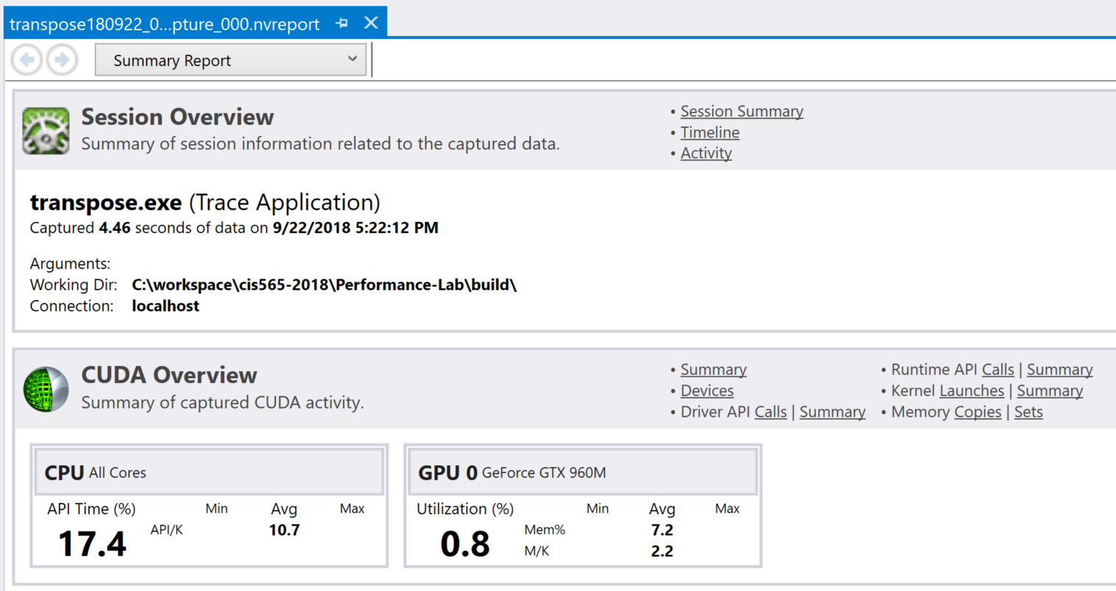
Produces a report
Notes:
https://docs.nvidia.com/nsight-visual-studio-edition/5.6/Nsight_Visual_Studio_Edition_User_Guide.htm#Analysis_Reports.htm%3FTocPath%3DAnalysis%2520Tools%7C_____2

Slide 10
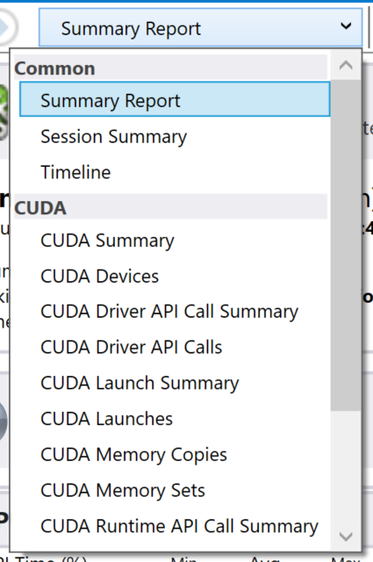
Produces a report
Notes:
https://docs.nvidia.com/nsight-visual-studio-edition/5.6/Nsight_Visual_Studio_Edition_User_Guide.htm#Analysis_Reports.htm%3FTocPath%3DAnalysis%2520Tools%7C_____2

Slide 11
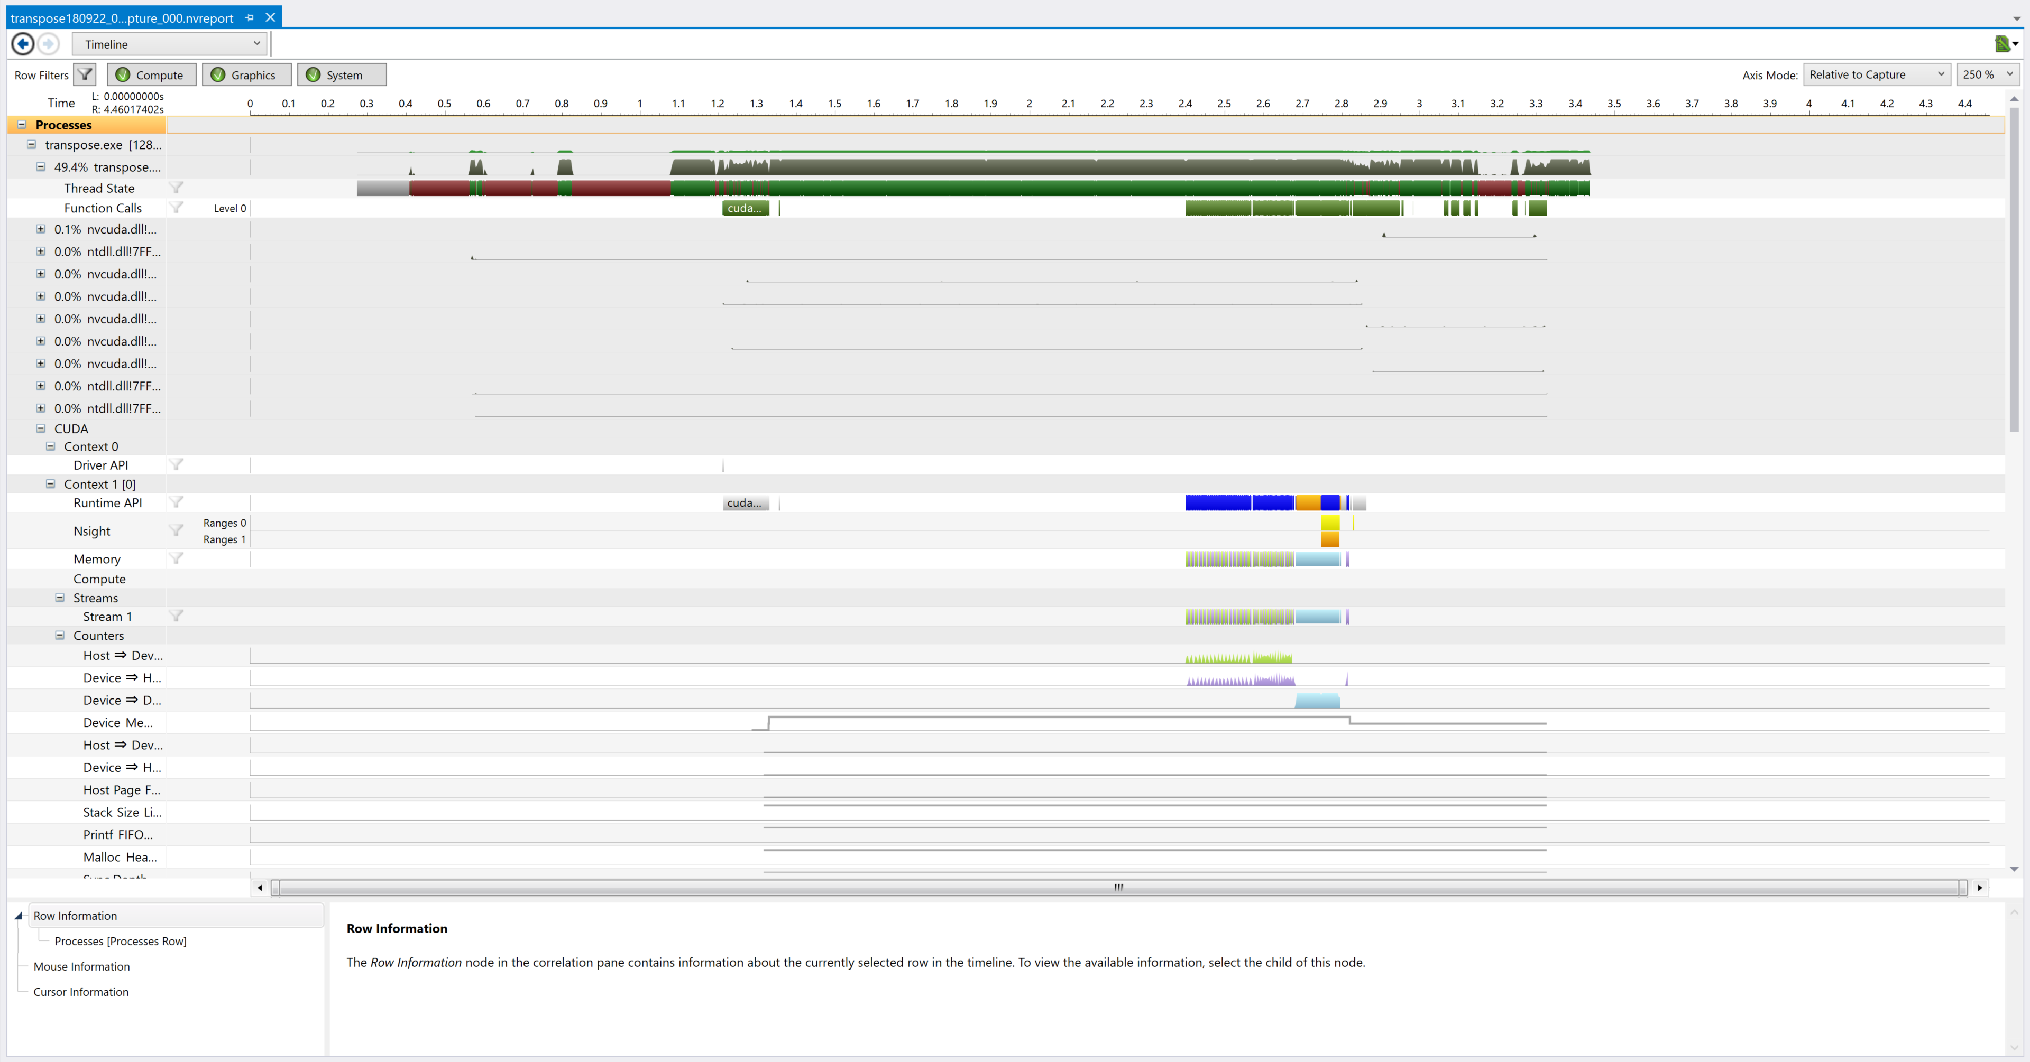
Timeline
https://docs.nvidia.com/nsight-visual-studio-edition/5.6/Nsight_Visual_Studio_Edition_User_Guide.htm#Timeline_Report.htm%3FTocPath%3DAnalysis%2520Tools%7COther%2520Analysis%2520Reports%7CTimeline%2520Page%7C_____0
Notes:
https://docs.nvidia.com/nsight-visual-studio-edition/5.6/Nsight_Visual_Studio_Edition_User_Guide.htm#Timeline_Report.htm%3FTocPath%3DAnalysis%2520Tools%7COther%2520Analysis%2520Reports%7CTimeline%2520Page%7C_____0

Slide 12
In Timeline, you can:
Click on individual function, API and kernel calls and find:
Start and end time in microseconds
See memory allocations, copies, types, direction, time, speed, size etc
See synchronization points – forced by user, forced by API etc
See kernel launches, execution, asynchronous behavior
Launch configuration and other API properties/arguments
See memory allocations over time
Double click to expand any row
*This is only a partial list
Notes:
CUDA memory allocations
Tools Extension -> Ranges
Paged/Pinned Memory transfer with size, speed, direction
Device to Device memory transfer with size, speed
Device to Host memory transfer with size, speed
Device memory allocated line graph (under Context 2 -> Counters)
CUDA memset before copy kernel
Copy kernel launches are different from CUDA kernel execution (asynchronous)

Slide 13
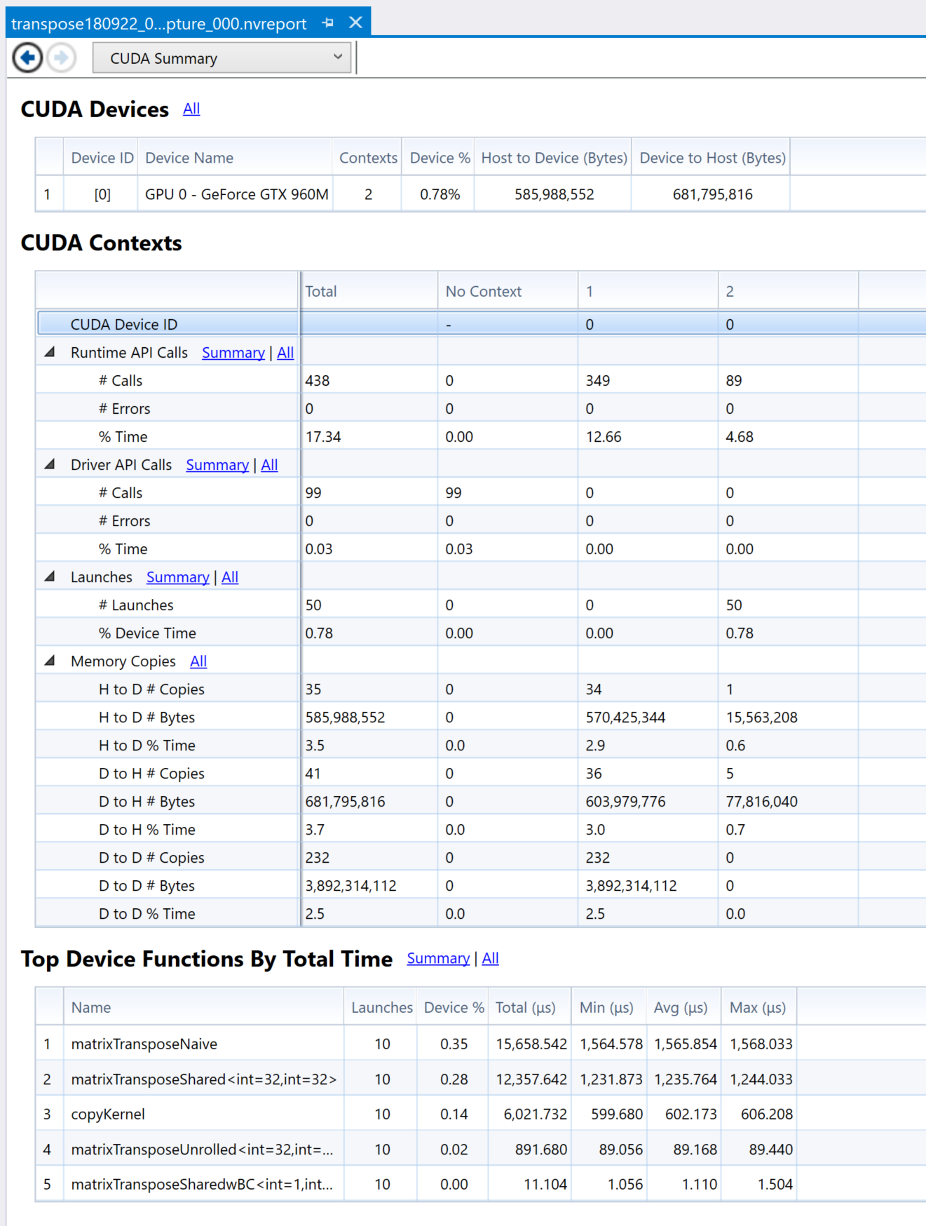
CUDA Summary

Slide 14
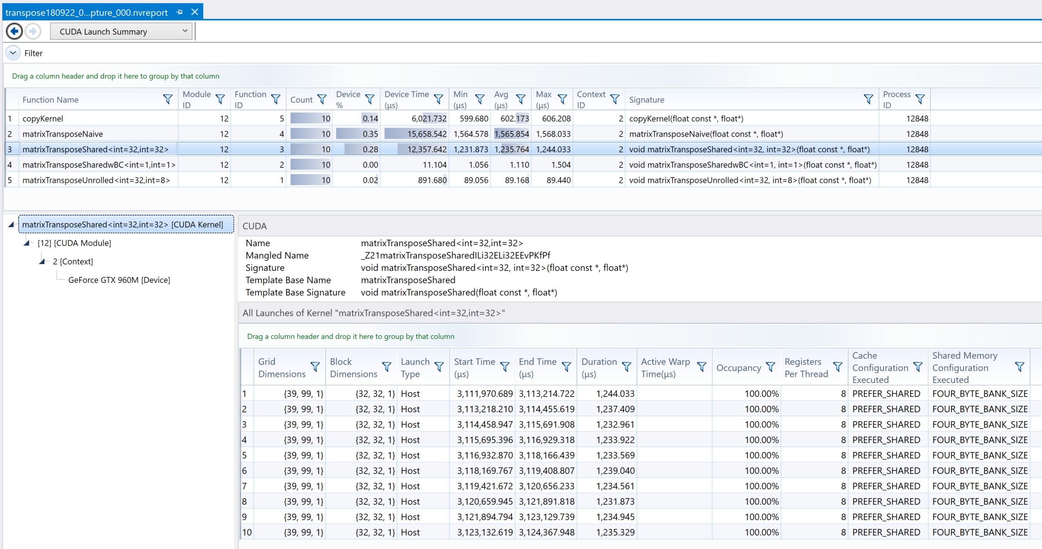
CUDA Launch Summary (Kernels - Grouped)

Slide 15
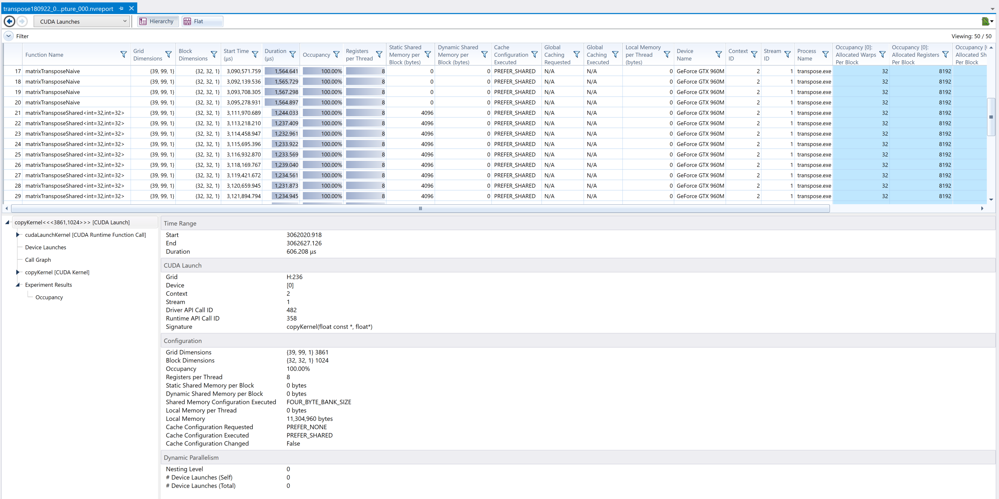
CUDA Launches (Kernels – by invocation)
Notes:
Show Experiment Results -> Occupancy

Slide 16
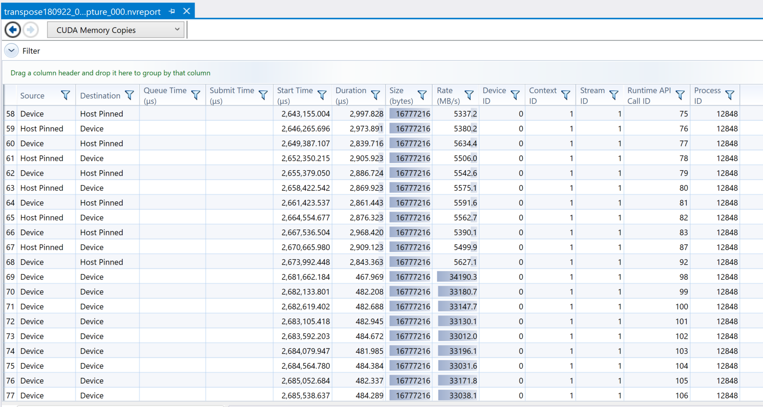
CUDA Memory Copies

Slide 17
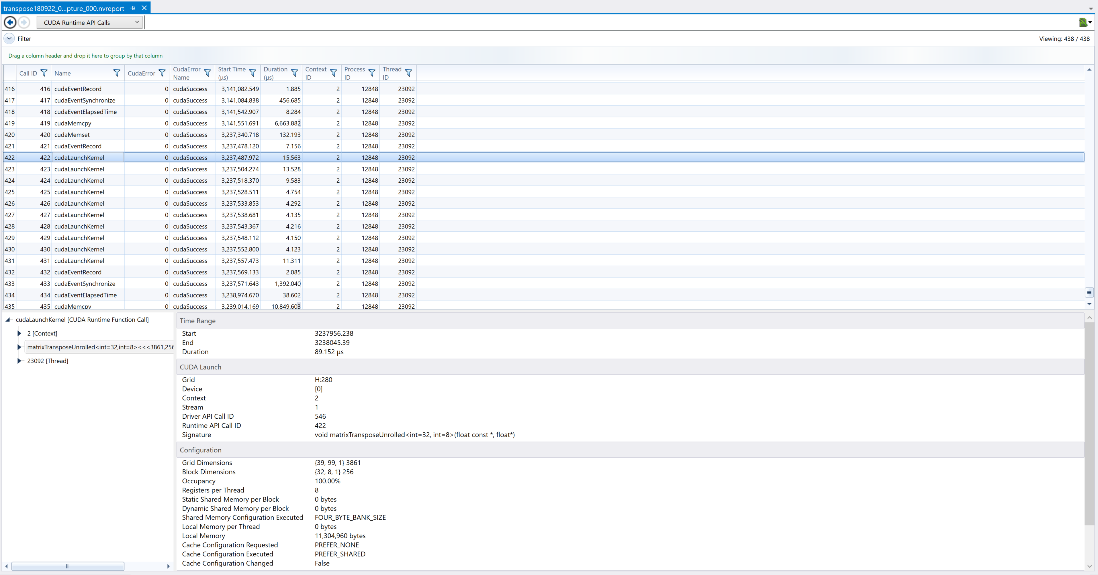
CUDA Runtime API Calls

Slide 18
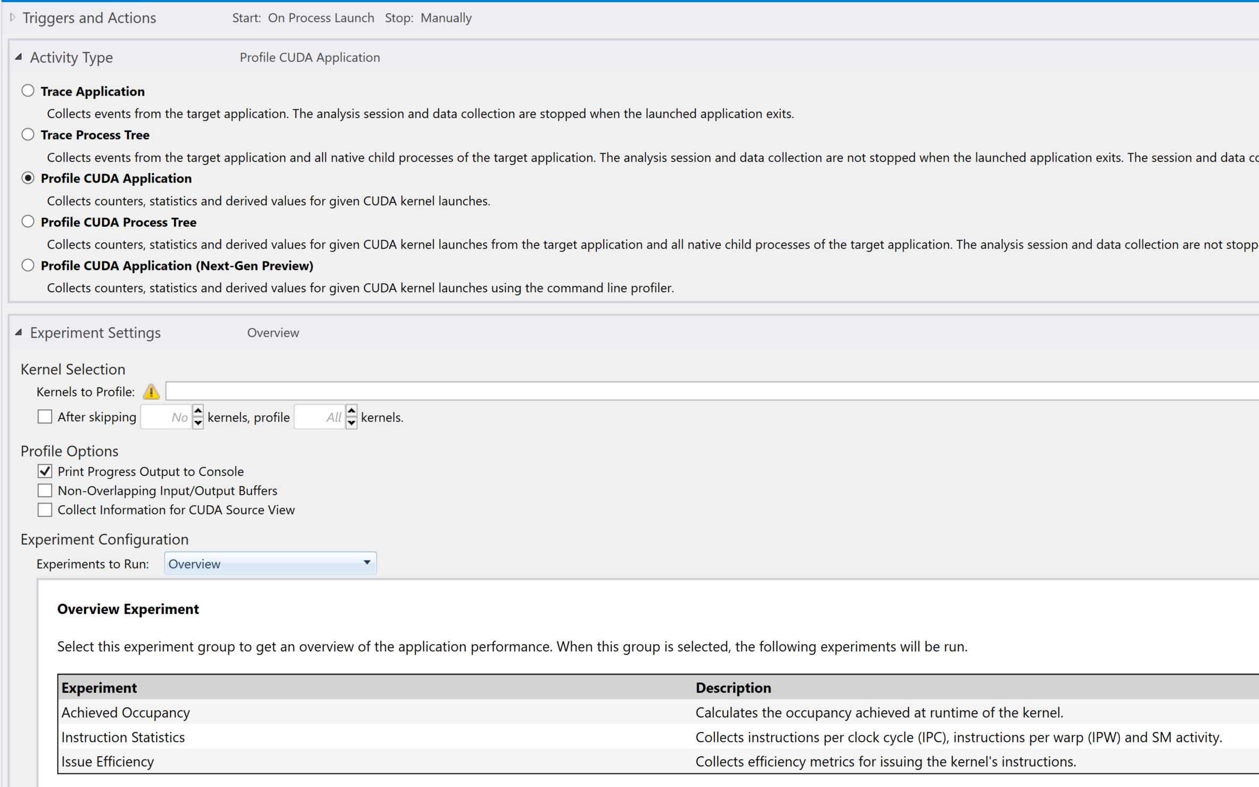
Let’s Profile CUDA Application
We’ll start with “Overview” Experiment
Notes:
https://docs.nvidia.com/nsight-visual-studio-edition/5.6/Nsight_Visual_Studio_Edition_User_Guide.htm#Profile_CUDA_Settings.htm%3FTocPath%3DAnalysis%2520Tools%7CCUDA%2520Experiments%7C_____0

Slide 19
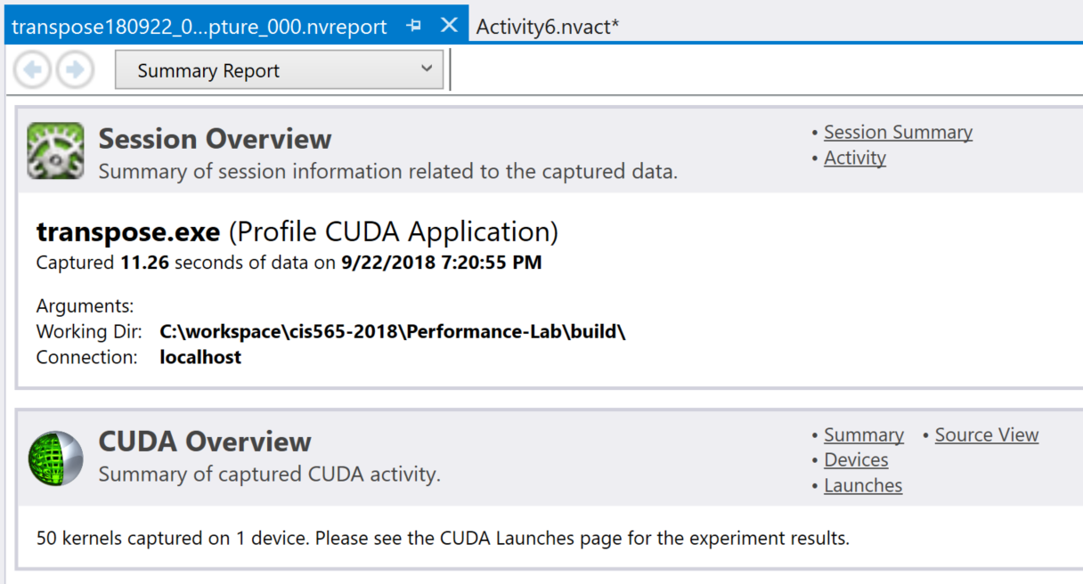
Produces a report

Slide 20
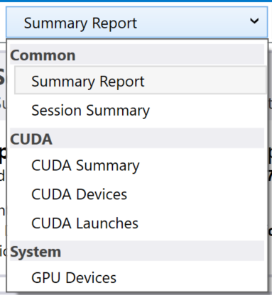
Produces a report

Slide 21
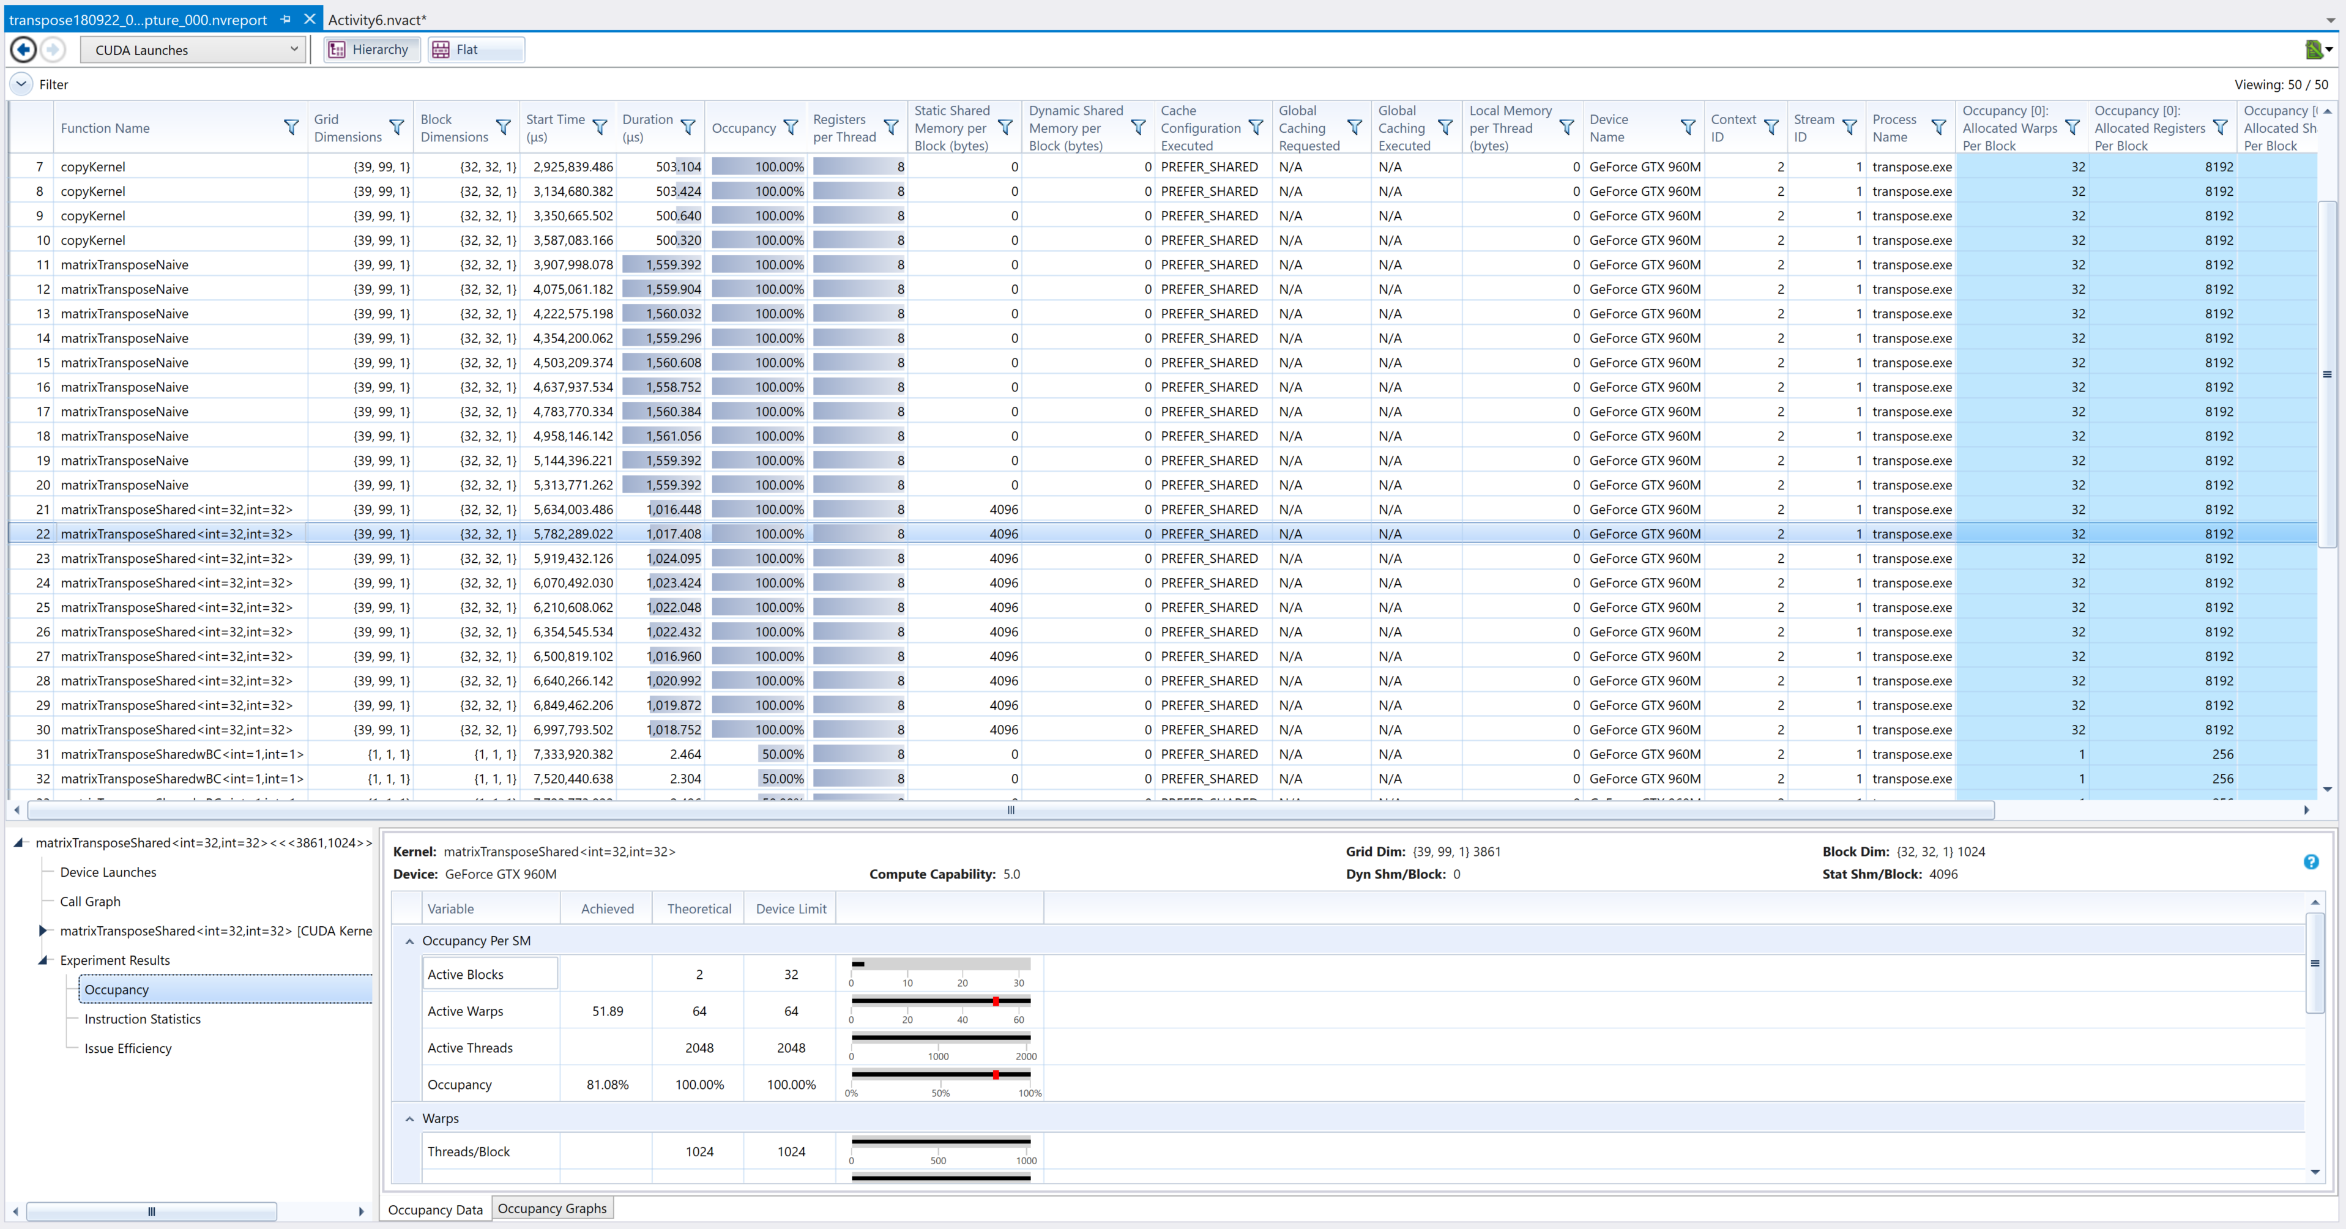
CUDA Launches

Slide 22
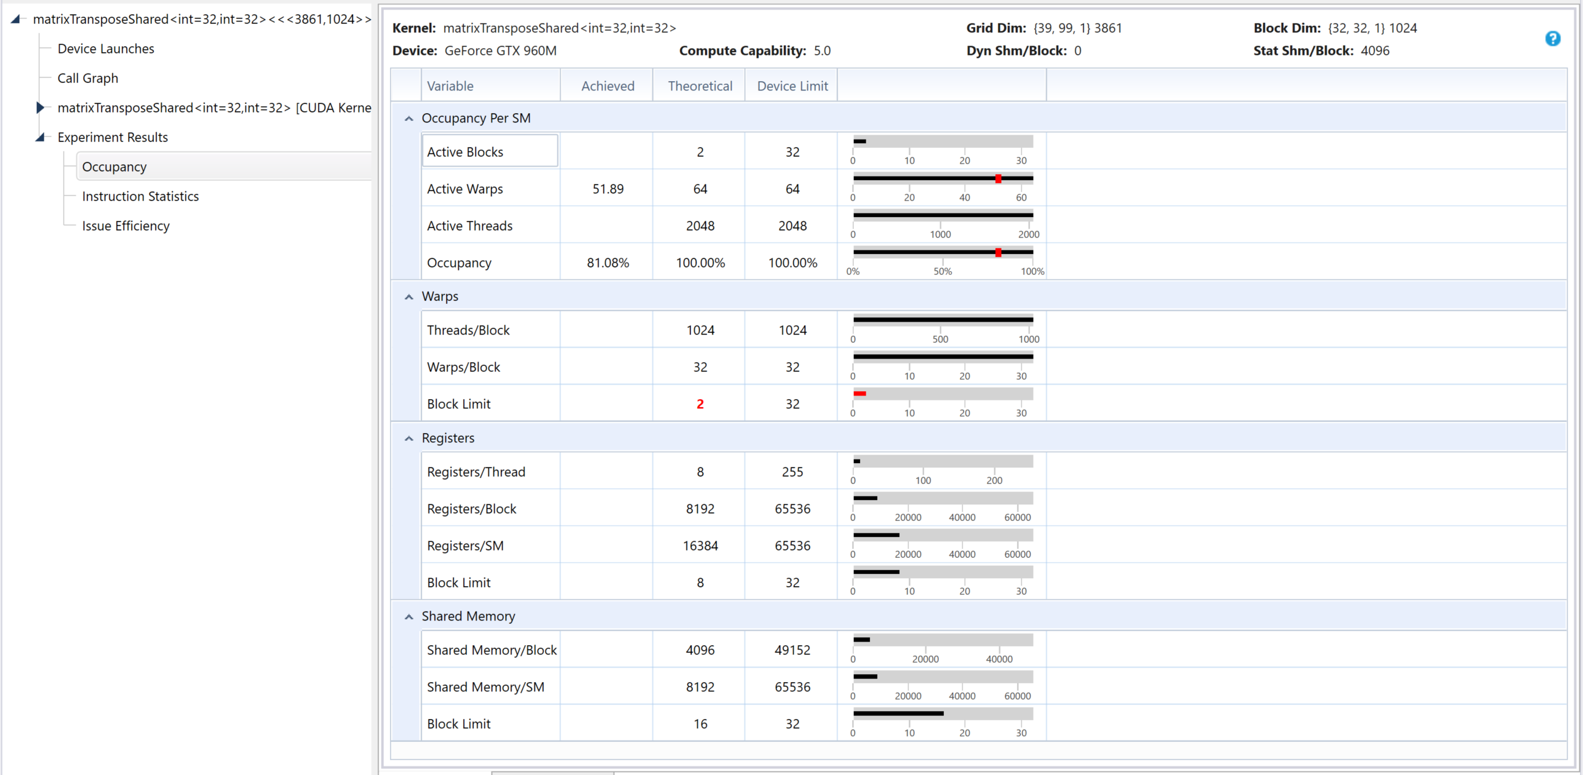
CUDA Launches – Occupancy Data
Notes:
https://docs.nvidia.com/nsight-visual-studio-edition/5.6/Nsight_Visual_Studio_Edition_User_Guide.htm#Analysis/Report/CudaExperiments/KernelLevel/AchievedOccupancy.htm%3FTocPath%3DAnalysis%2520Tools%7CCUDA%2520Experiments%7CKernel-Level%2520Experiments%7C_____1

Slide 23
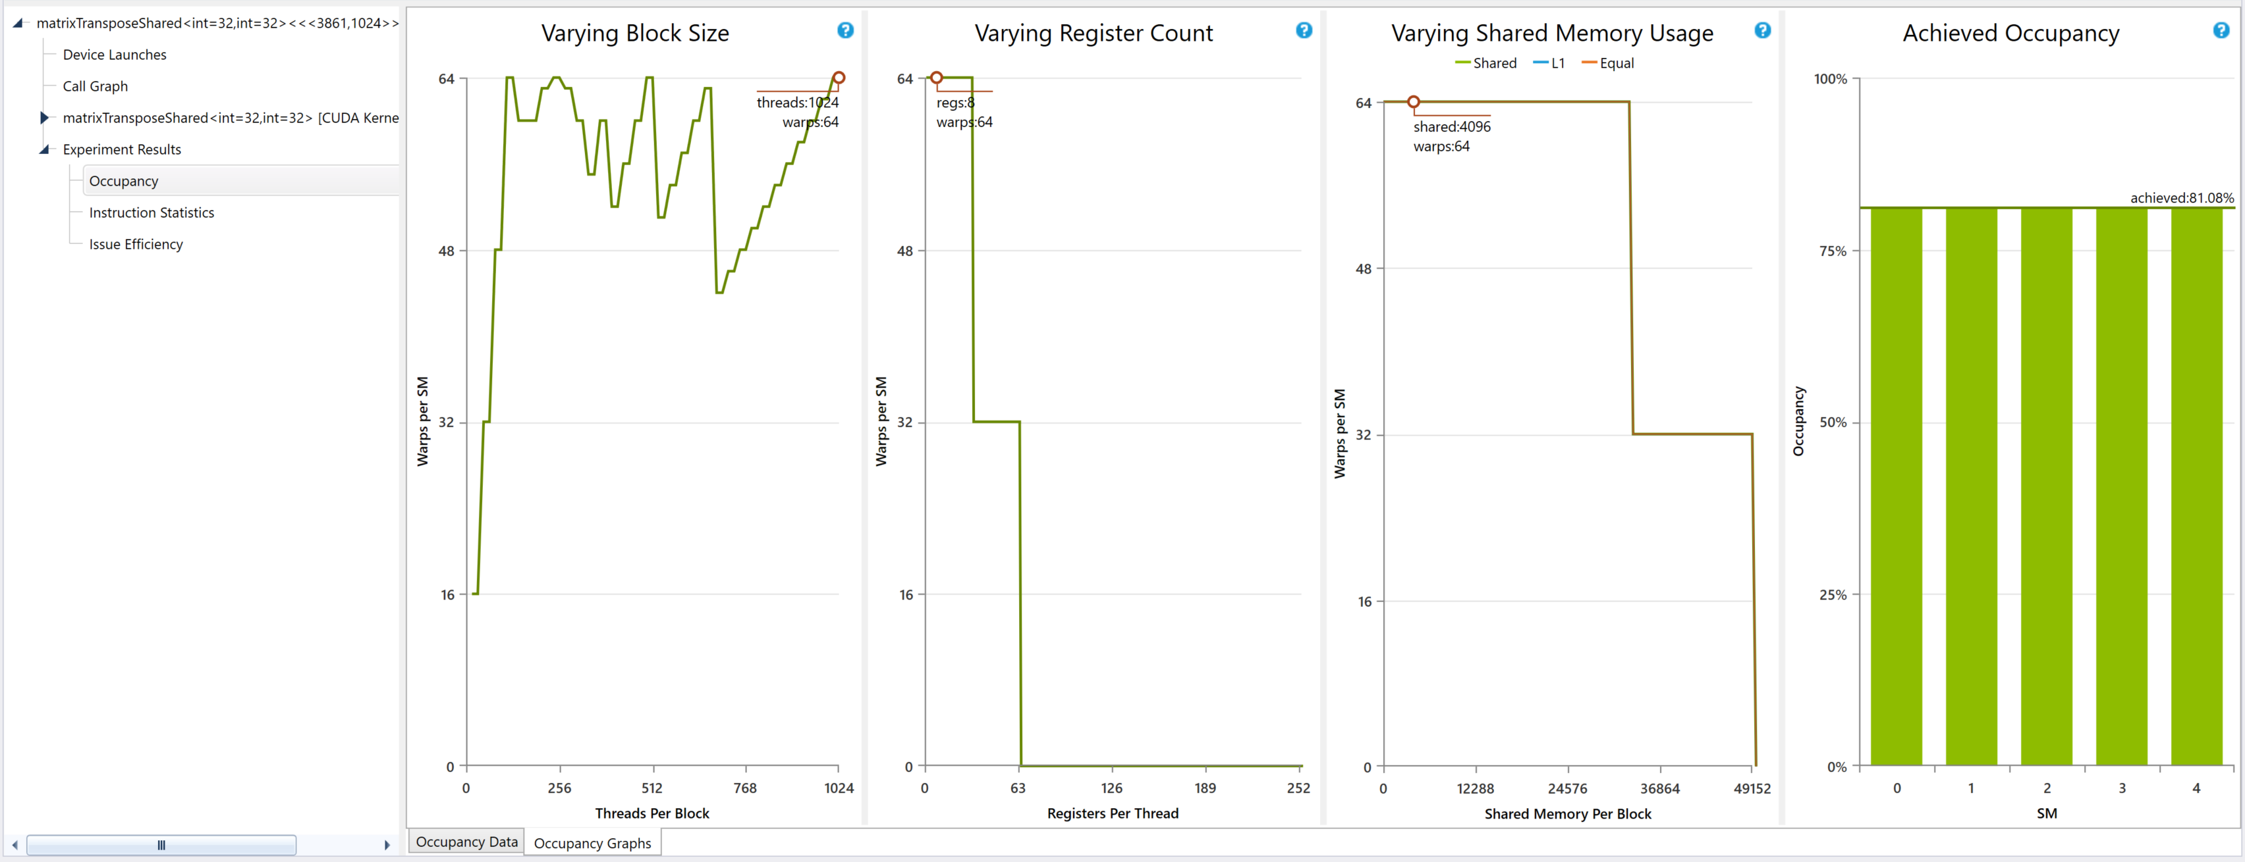
CUDA Launches – Occupancy Graph
Notes:
https://docs.nvidia.com/nsight-visual-studio-edition/5.6/Nsight_Visual_Studio_Edition_User_Guide.htm#Analysis/Report/CudaExperiments/KernelLevel/AchievedOccupancy.htm%3FTocPath%3DAnalysis%2520Tools%7CCUDA%2520Experiments%7CKernel-Level%2520Experiments%7C_____1

Slide 24
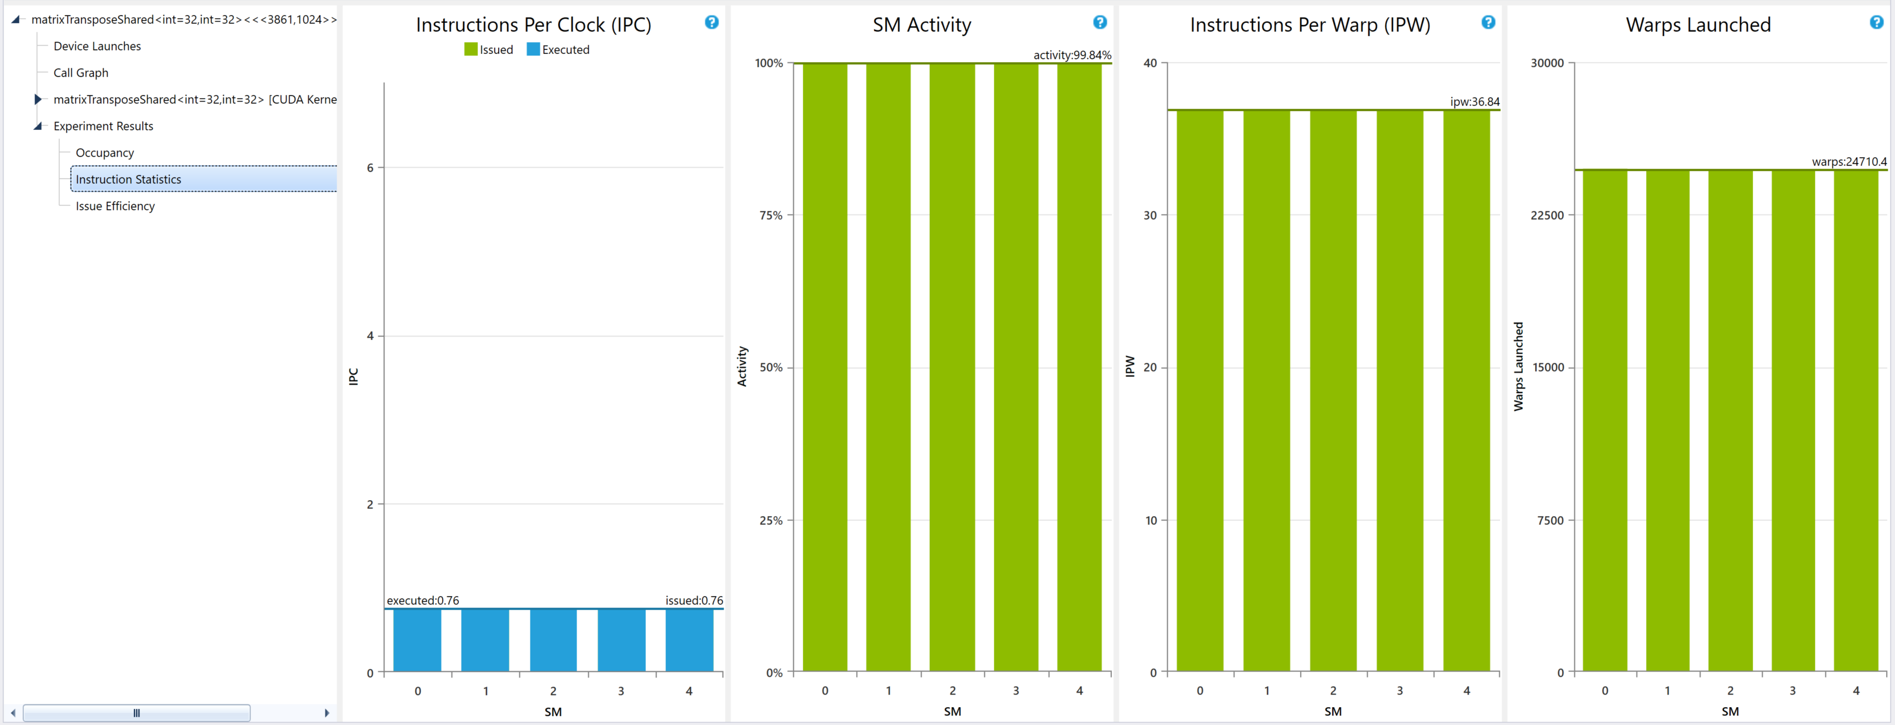
CUDA Launches – Instruction Statistics
Notes:
https://docs.nvidia.com/nsight-visual-studio-edition/5.6/Nsight_Visual_Studio_Edition_User_Guide.htm#Analysis/Report/CudaExperiments/KernelLevel/InstructionStatistics.htm%3FTocPath%3DAnalysis%2520Tools%7CCUDA%2520Experiments%7CKernel-Level%2520Experiments%7C_____4

Slide 25
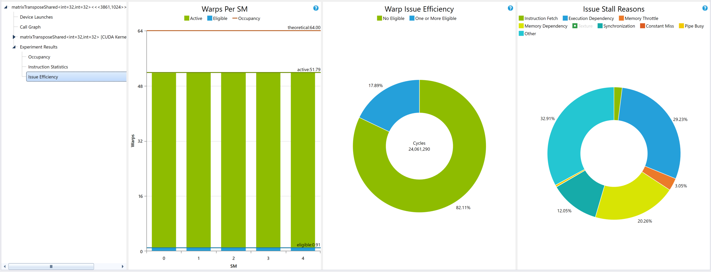
CUDA Launches – Issue Eficiency
Notes:
https://docs.nvidia.com/nsight-visual-studio-edition/5.6/Nsight_Visual_Studio_Edition_User_Guide.htm#Analysis/Report/CudaExperiments/KernelLevel/IssueEfficiency.htm%3FTocPath%3DAnalysis%2520Tools%7CCUDA%2520Experiments%7CKernel-Level%2520Experiments%7C_____5

Slide 26
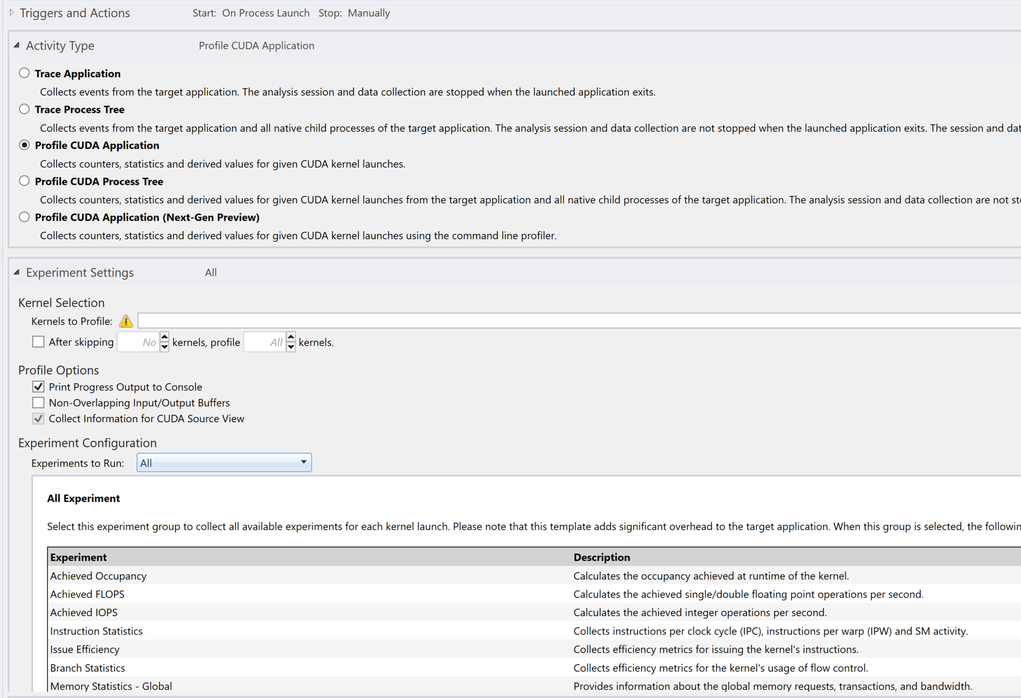
Let’s Profile CUDA Application
This time “All” Experiment

Slide 27
CUDA Launches
Occupancy, Instructions statistics, Issue Efficiency
Same as before
Now includes:
Branch Statistics
Achieved FLOPS / IOPS (Interger OPS)
Pipe Utilization
Memory Statistics
Along with “CUDA Source View”, include assembly/PTX instructions
Add –lineinfo flag for source code view

Slide 28
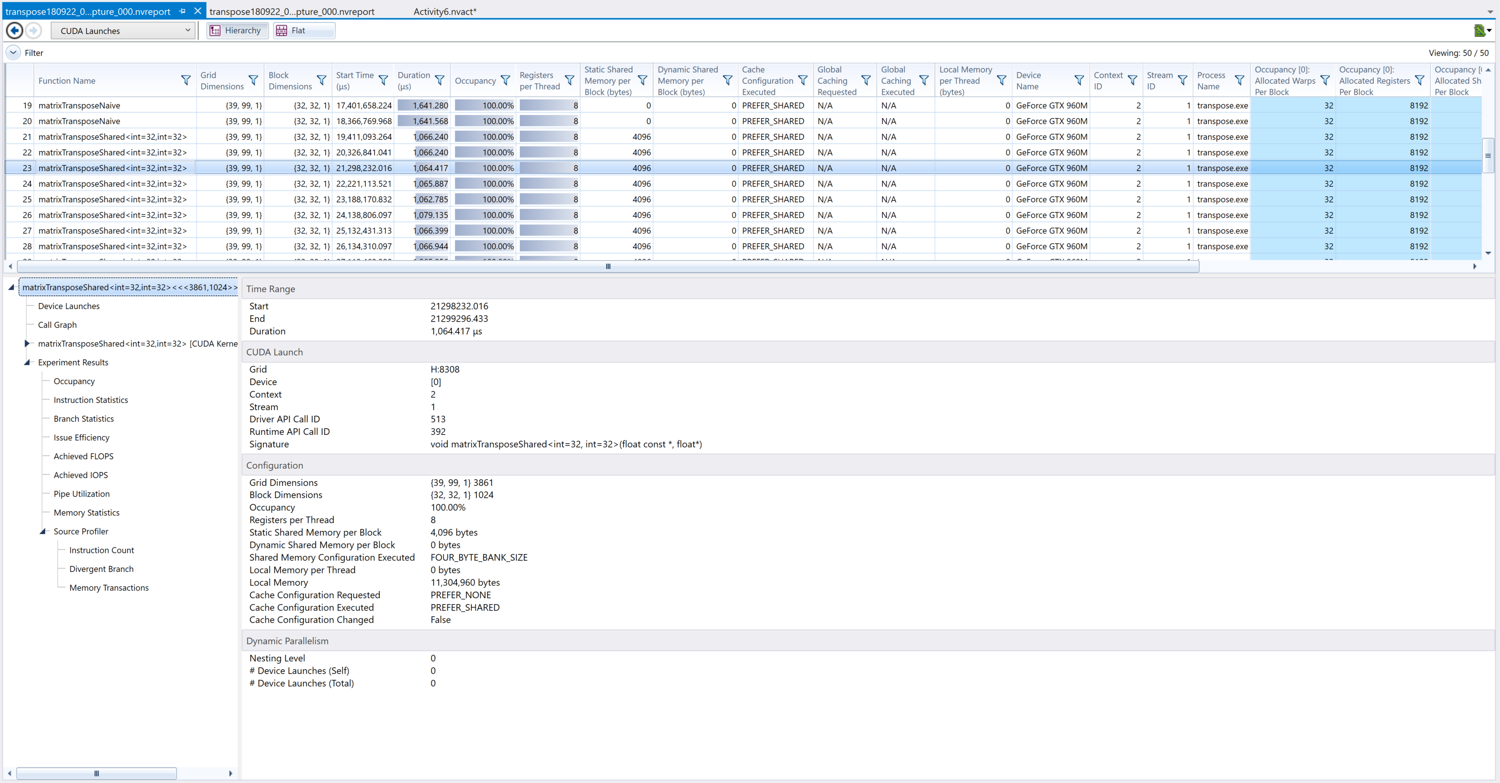
CUDA Launches

Slide 29
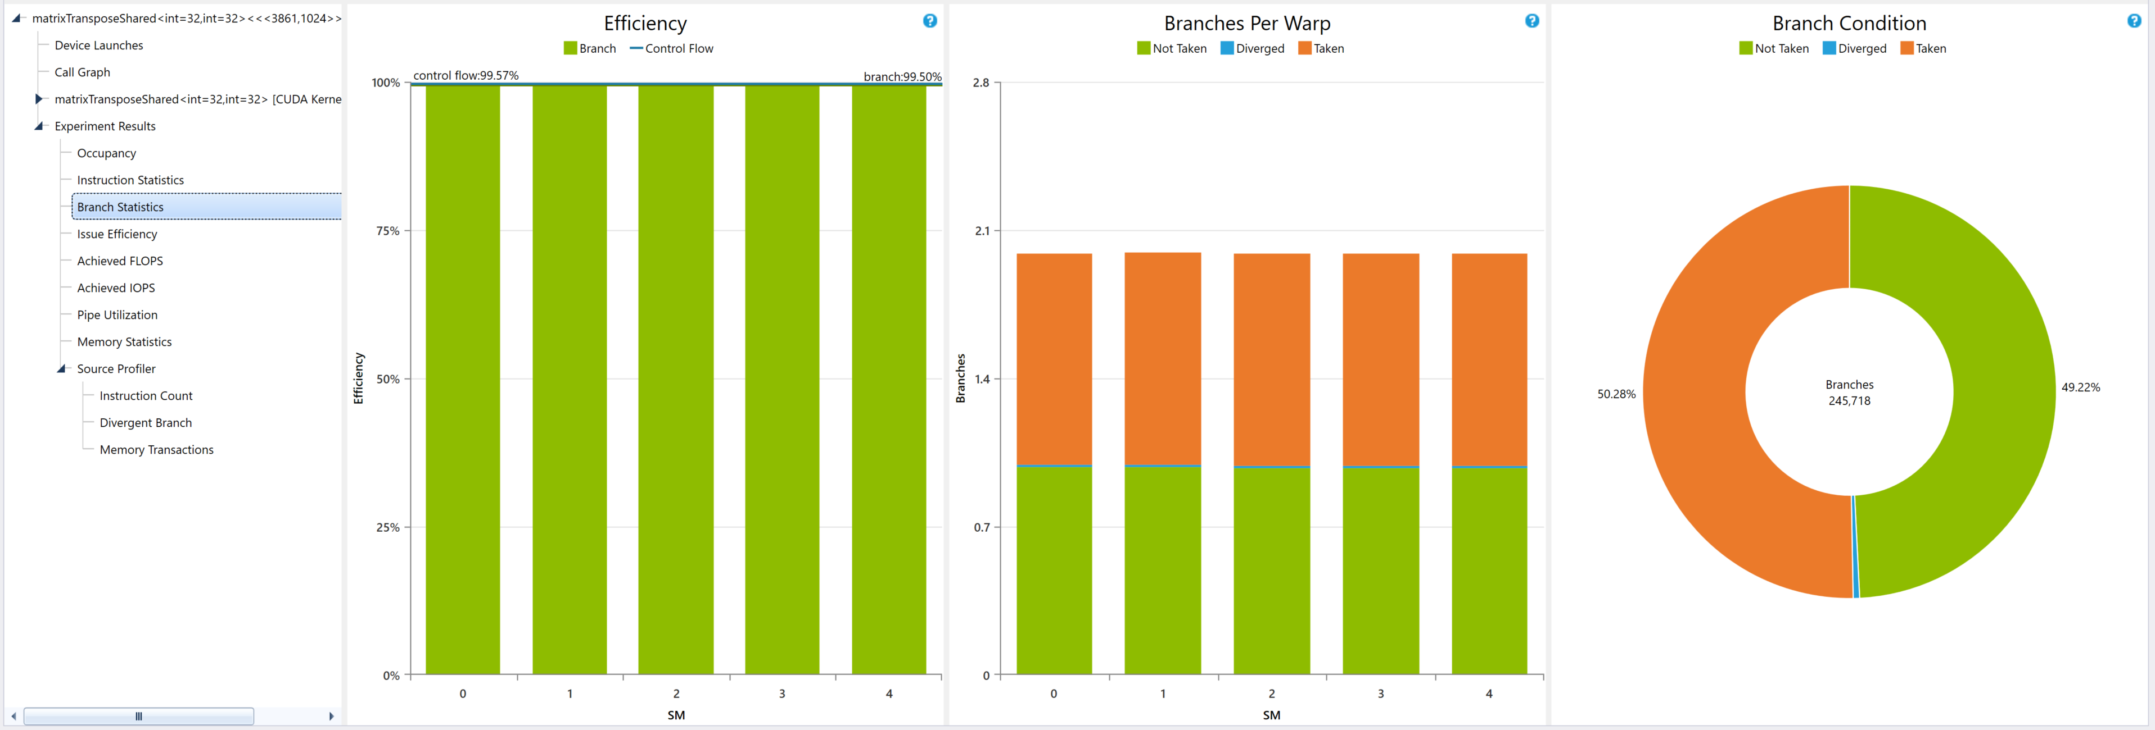
CUDA Launches – Branch Statistics
https://docs.nvidia.com/nsight-visual-studio-edition/5.6/Nsight_Visual_Studio_Edition_User_Guide.htm#Analysis/Report/CudaExperiments/KernelLevel/BranchStatistics.htm%3FTocPath%3DAnalysis%2520Tools%7CCUDA%2520Experiments%7CKernel-Level%2520Experiments%7C_____6

Slide 30
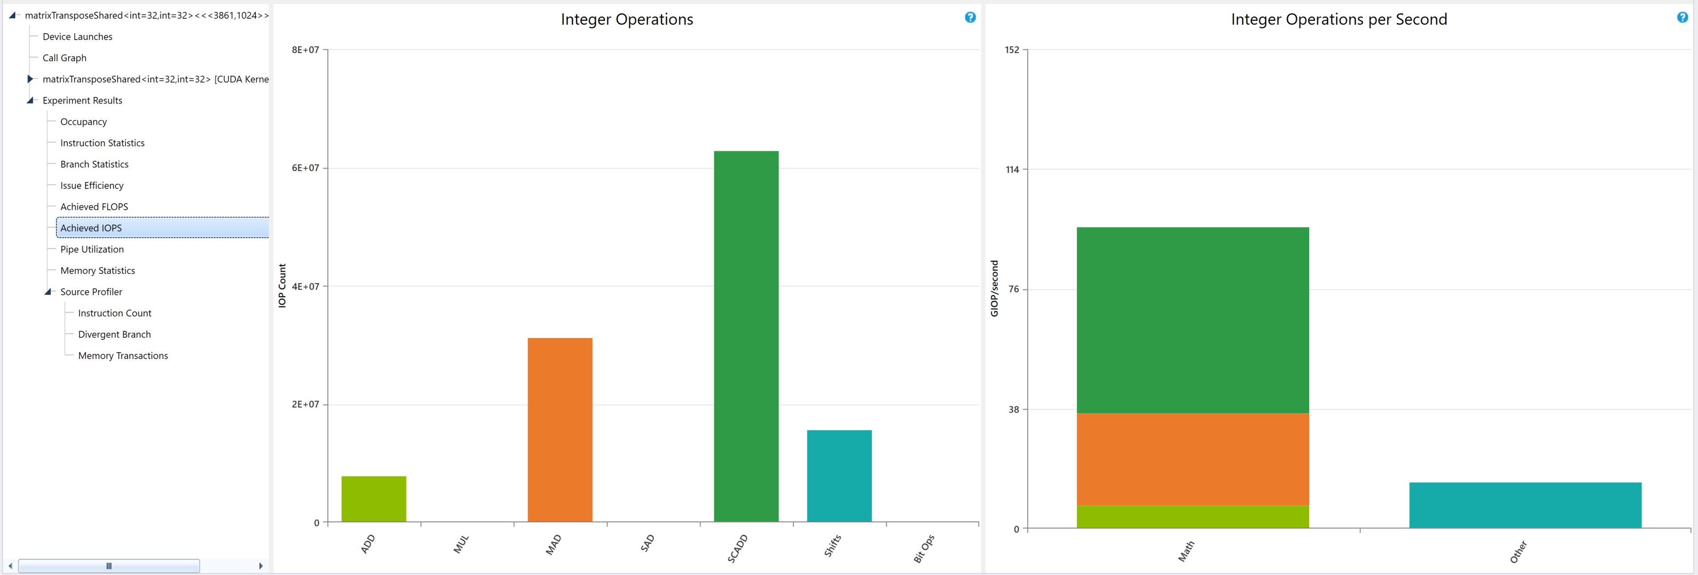
CUDA Launches – Achieved FLOPS/IOPS
https://docs.nvidia.com/nsight-visual-studio-edition/5.6/Nsight_Visual_Studio_Edition_User_Guide.htm#Analysis/Report/CudaExperiments/KernelLevel/AchievedFlops.htm%3FTocPath%3DAnalysis%2520Tools%7CCUDA%2520Experiments%7CKernel-Level%2520Experiments%7C_____2
https://docs.nvidia.com/nsight-visual-studio-edition/5.6/Nsight_Visual_Studio_Edition_User_Guide.htm#Analysis/Report/CudaExperiments/KernelLevel/AchievedIops.htm%3FTocPath%3DAnalysis%2520Tools%7CCUDA%2520Experiments%7CKernel-Level%2520Experiments%7C_____3

Slide 31
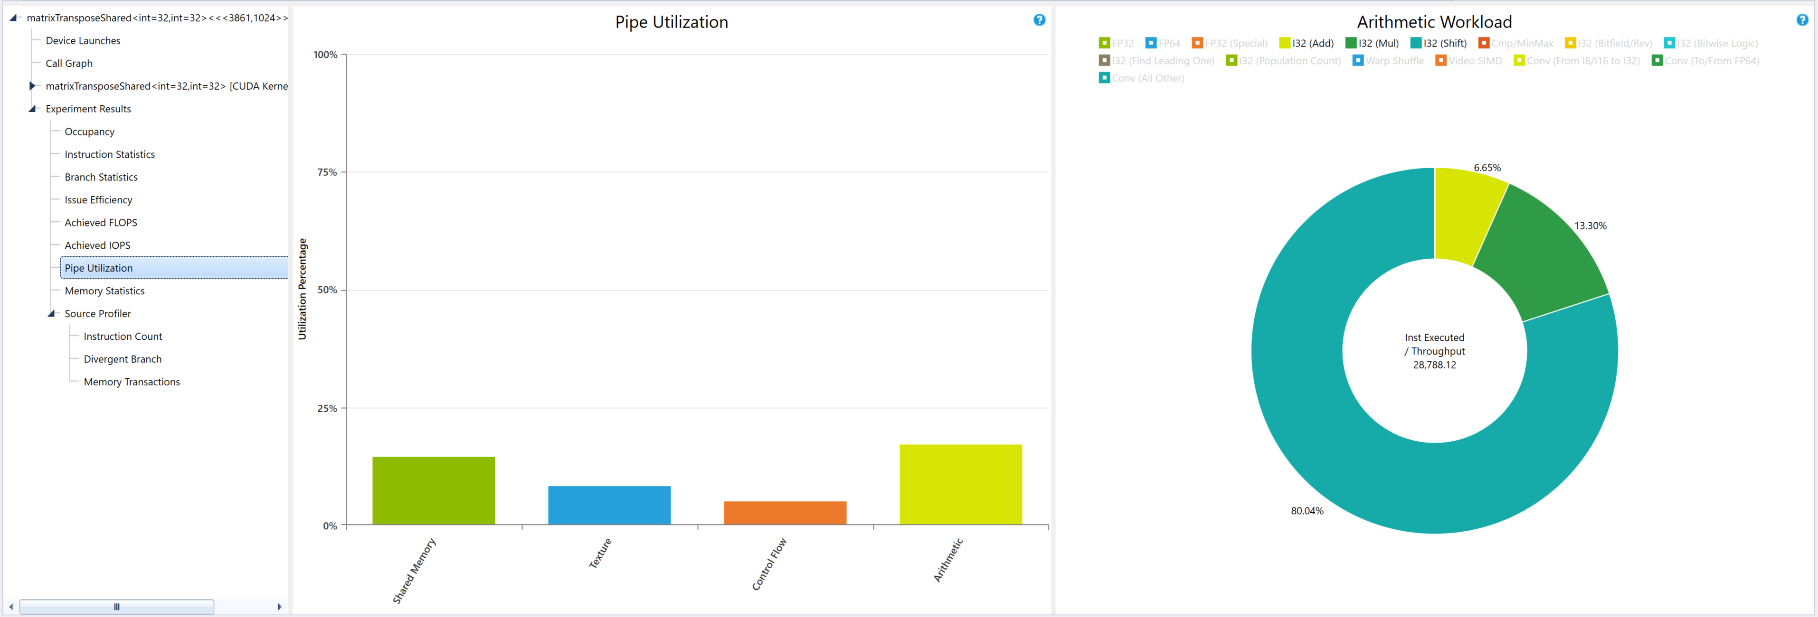
CUDA Launches – Pipe Utilization
https://docs.nvidia.com/nsight-visual-studio-edition/5.6/Nsight_Visual_Studio_Edition_User_Guide.htm#Analysis/Report/CudaExperiments/KernelLevel/PipeUtilization.htm%3FTocPath%3DAnalysis%2520Tools%7CCUDA%2520Experiments%7CKernel-Level%2520Experiments%7C_____8

Slide 32
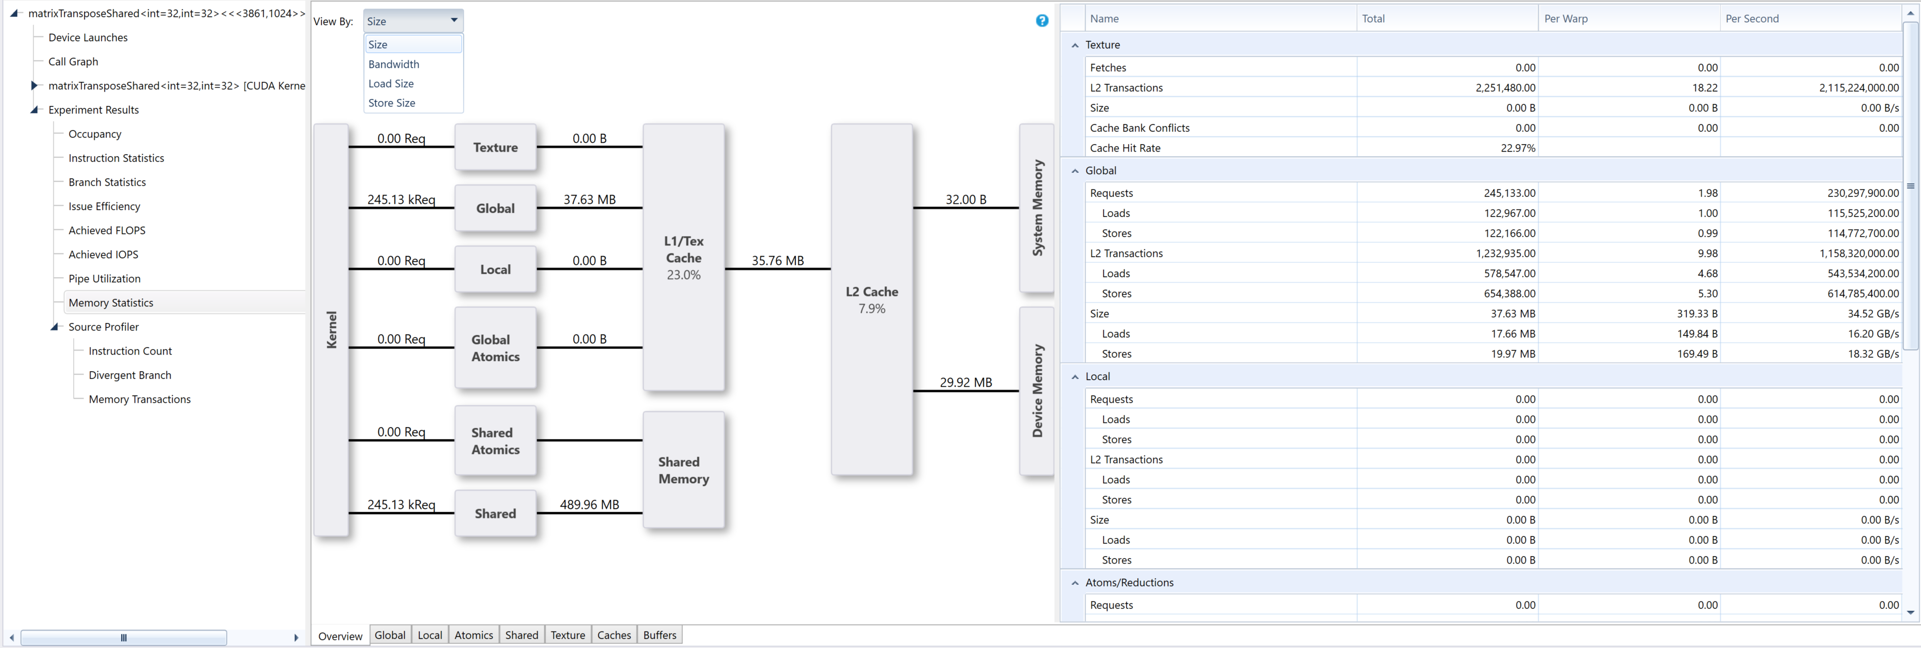
CUDA Launches – Memory Statistics
https://docs.nvidia.com/nsight-visual-studio-edition/5.6/Nsight_Visual_Studio_Edition_User_Guide.htm#Analysis/Report/CudaExperiments/KernelLevel/MemoryStatistics.htm%3FTocPath%3DAnalysis%2520Tools%7CCUDA%2520Experiments%7CKernel-Level%2520Experiments%7CMemory%2520Statistics%7C_____0

Slide 33
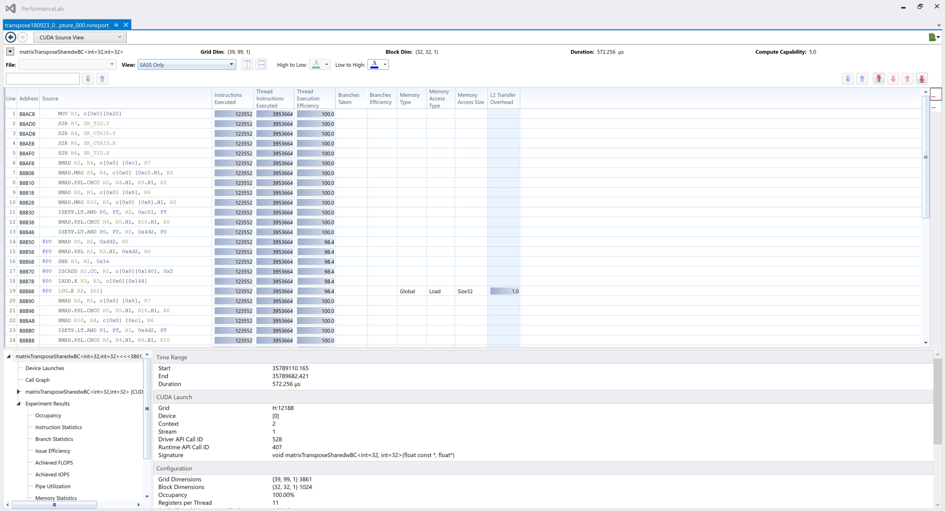
CUDA Source View

Slide 34
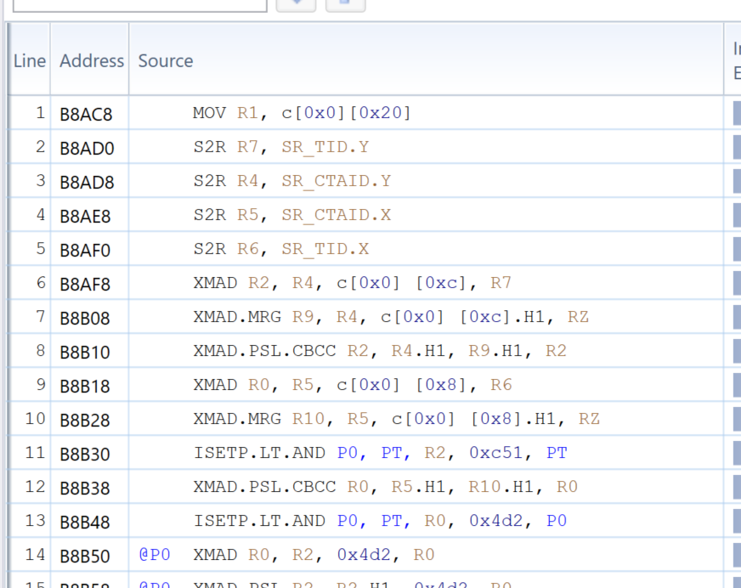
CUDA Source View

Slide 35

CUDA Source View

Slide 36
CUDA Source View
Release configuration does not include source code in .exe
Need to enable the -lineinfo compile option
Note: Also a security issue, anyone can reverse engineer your code
For pure Visual Studio Projects:
Project Properties page -> CUDA/C++ > Device.
For the field Generate Line Number Information, the default setting is No. Change to Yes (-lineinfo). Then click OK.
For CMake / Performance Lab, change line 39 of Cmakelists.txt
LIST(APPEND CUDA_NVCC_FLAGS ${CUDA_GENERATE_CODE}) to LIST(APPEND CUDA_NVCC_FLAGS ${CUDA_GENERATE_CODE} -lineinfo)
https://docs.nvidia.com/nsight-visual-studio-edition/5.6/Nsight_Visual_Studio_Edition_User_Guide.htm#Analysis_Source_Code_Correlation.htm?Highlight=lineinfo

Slide 37
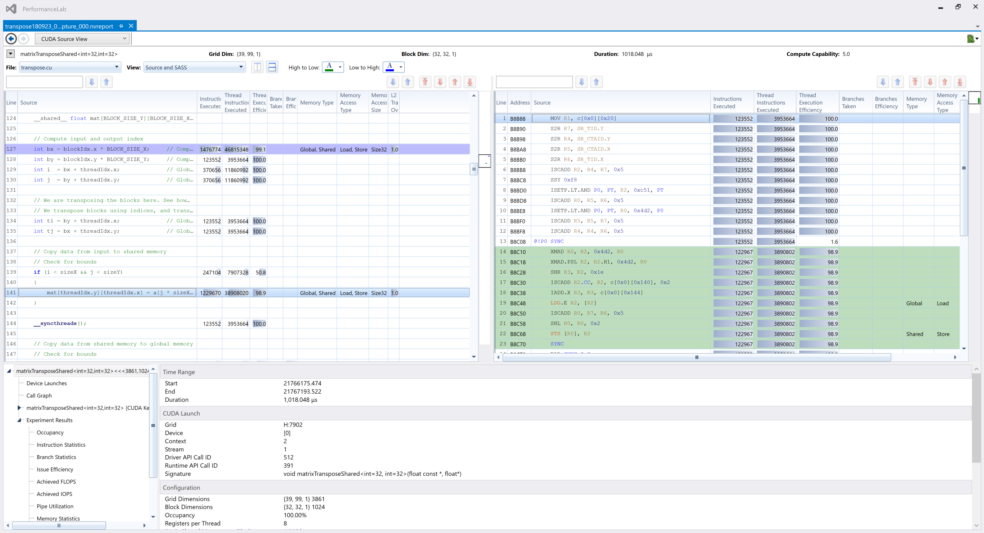
CUDA Source View
https://docs.nvidia.com/nsight-visual-studio-edition/5.6/Nsight_Visual_Studio_Edition_User_Guide.htm#Analysis/Report/CudaExperiments/Source_Level_Experiments.htm%3FTocPath%3DAnalysis%2520Tools%7CCUDA%2520Experiments%7CSource-Level%2520Experiments%7C_____0

Slide 38

CUDA Source View
https://docs.nvidia.com/nsight-visual-studio-edition/5.6/Nsight_Visual_Studio_Edition_User_Guide.htm#Analysis/Report/CudaExperiments/Source_Level_Experiments.htm%3FTocPath%3DAnalysis%2520Tools%7CCUDA%2520Experiments%7CSource-Level%2520Experiments%7C_____0

Slide 39
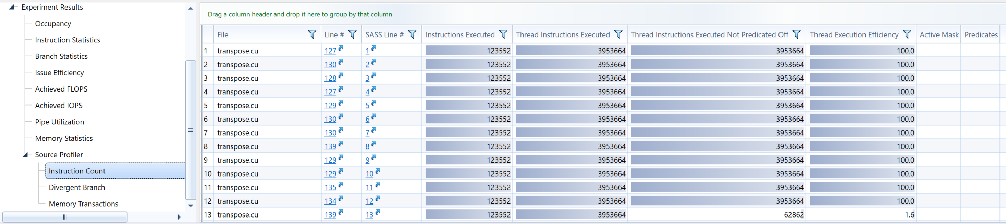
CUDA Source View - Instruction Count
Identifies instructions which do not execute for all threads in the warp
Hyperlinks to source code lines
https://docs.nvidia.com/nsight-visual-studio-edition/5.6/Nsight_Visual_Studio_Edition_User_Guide.htm#Analysis/Report/CudaExperiments/SourceLevel/InstructionCount.htm%3FTocPath%3DAnalysis%2520Tools%7CCUDA%2520Experiments%7CSource-Level%2520Experiments%7C_____2

Slide 40
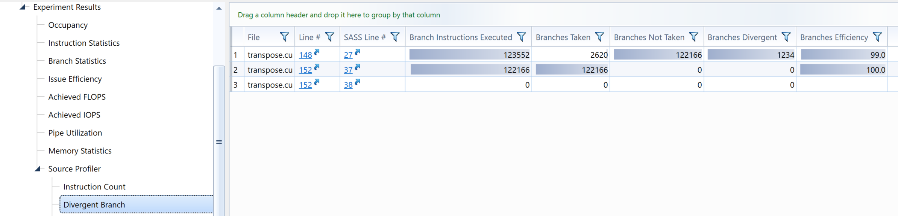
CUDA Source View – Divergent Branch
Finds branch-able instructions then count how many times each branch:
was taken by any threads in the warp
not taken by any threads in the warp
diverged (some threads branched and some did not).
Hyperlinks to source code of branchable code
https://docs.nvidia.com/nsight-visual-studio-edition/5.6/Nsight_Visual_Studio_Edition_User_Guide.htm#Analysis/Report/CudaExperiments/SourceLevel/DivergentBranch.htm%3FTocPath%3DAnalysis%2520Tools%7CCUDA%2520Experiments%7CSource-Level%2520Experiments%7C_____1

Slide 41
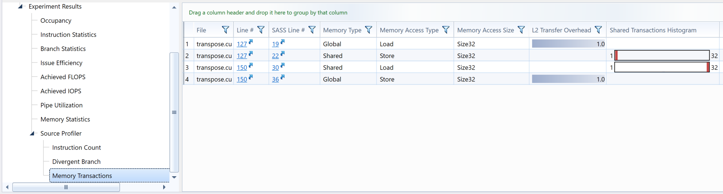
CUDA Source View – Memory Tranx
Detailed statistics for memory transactions
Distribution of executed L1 memory transactions per instruction executed. Bins with a non-zero count have gray bars, and the highest bin has a red bar. A good histogram has only counts in the lower bins.
Hyperlinks to source code of branchable code
https://docs.nvidia.com/nsight-visual-studio-edition/5.6/Nsight_Visual_Studio_Edition_User_Guide.htm#Analysis/Report/CudaExperiments/SourceLevel/MemoryTransactions.htm%3FTocPath%3DAnalysis%2520Tools%7CCUDA%2520Experiments%7CSource-Level%2520Experiments%7C_____3

Slide 42
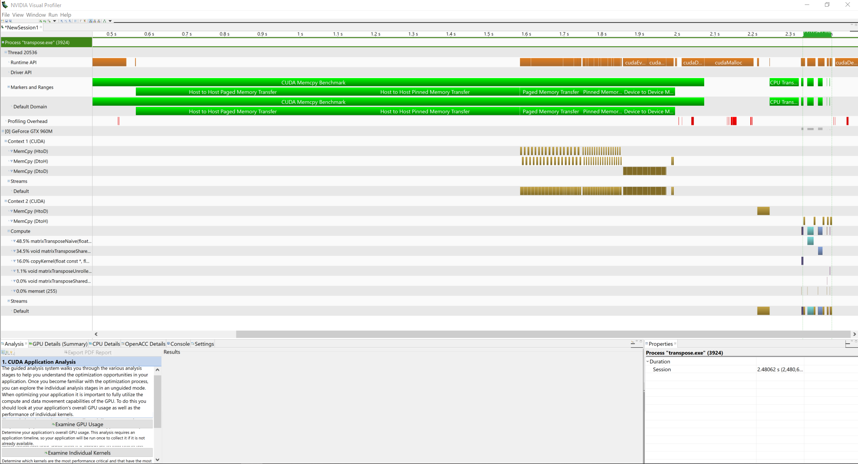
Visual Profiler
https://docs.nvidia.com/cuda/archive/9.2/profiler-users-guide/index.html#visual

Slide 43
Visual Profiler
Allows you to visualize and optimize the performance of your application.
Primary tool is the timeline.
Detect potential performance bottlenecks.
Also suggests how to take action to eliminate or reduce those bottlenecks.
Standalone application and available on Linux.

Slide 44
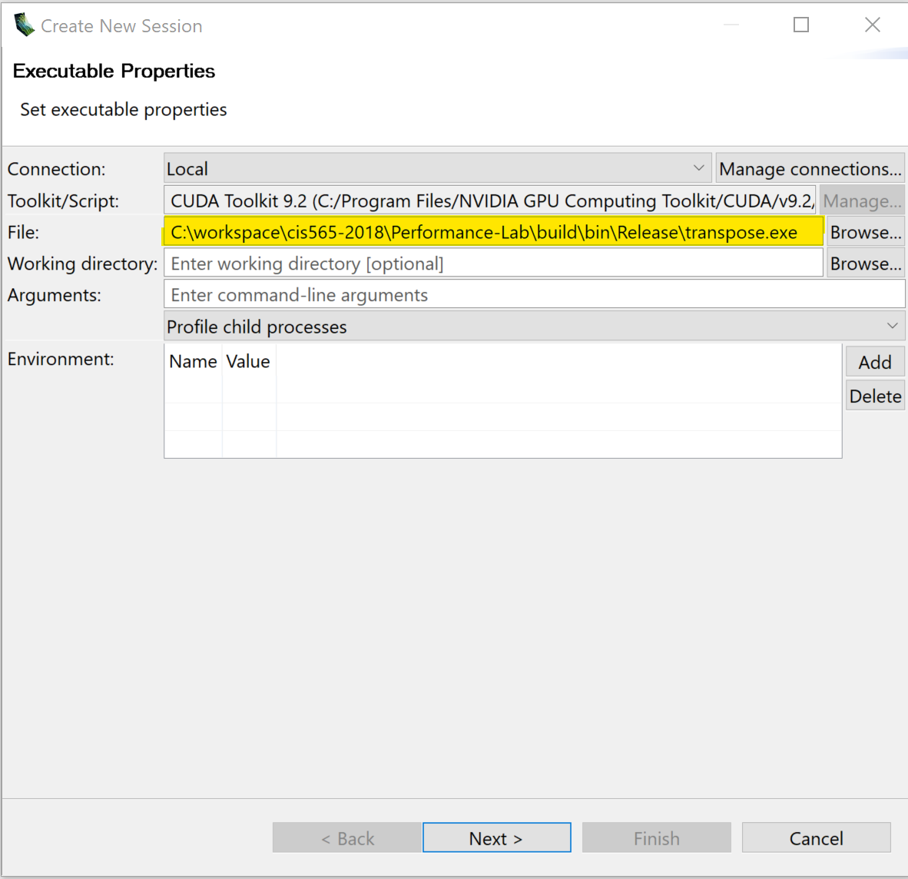
Starting the Profiler
Specify executable
Also allows specifying
Working directory
CLI arguments
Custom environment variables
Click Next, use the default options
Click finish

Slide 45
Timeline

Slide 46
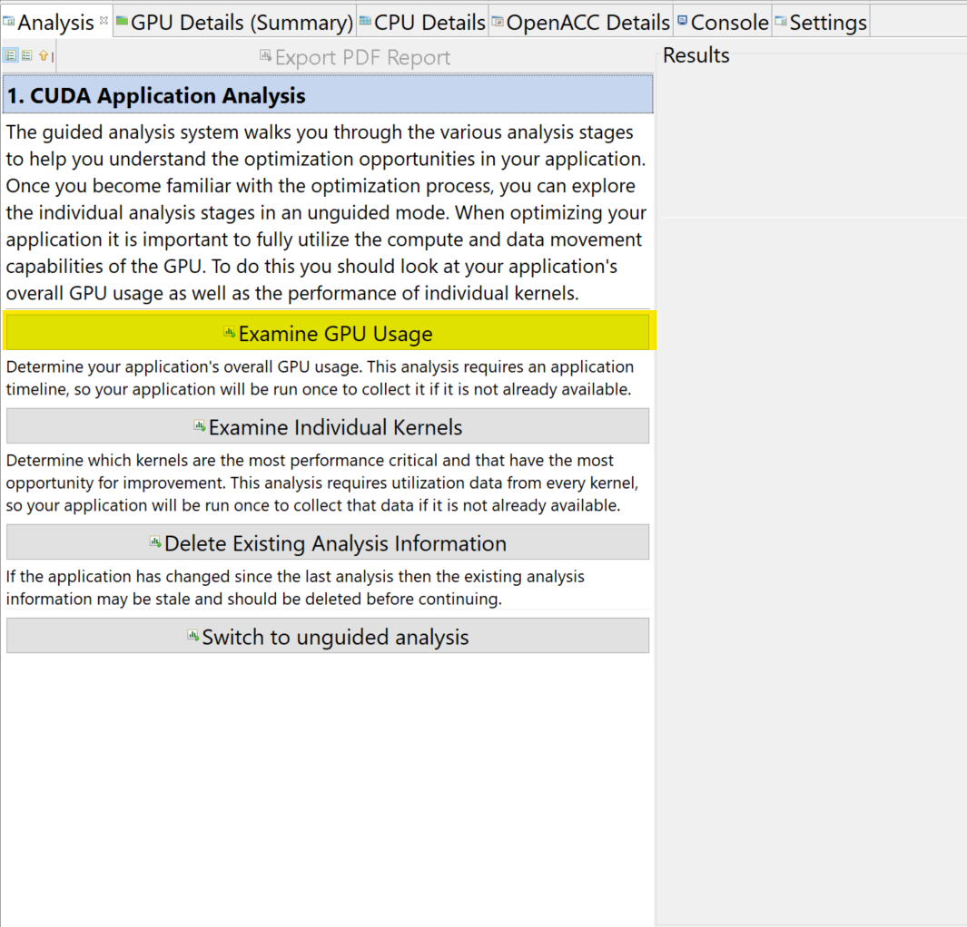
Guided Analysis
Profiler examines the application and gives suggestions on what can be improved
https://docs.nvidia.com/cuda/archive/9.2/profiler-users-guide/index.html#analysis-view

Slide 47
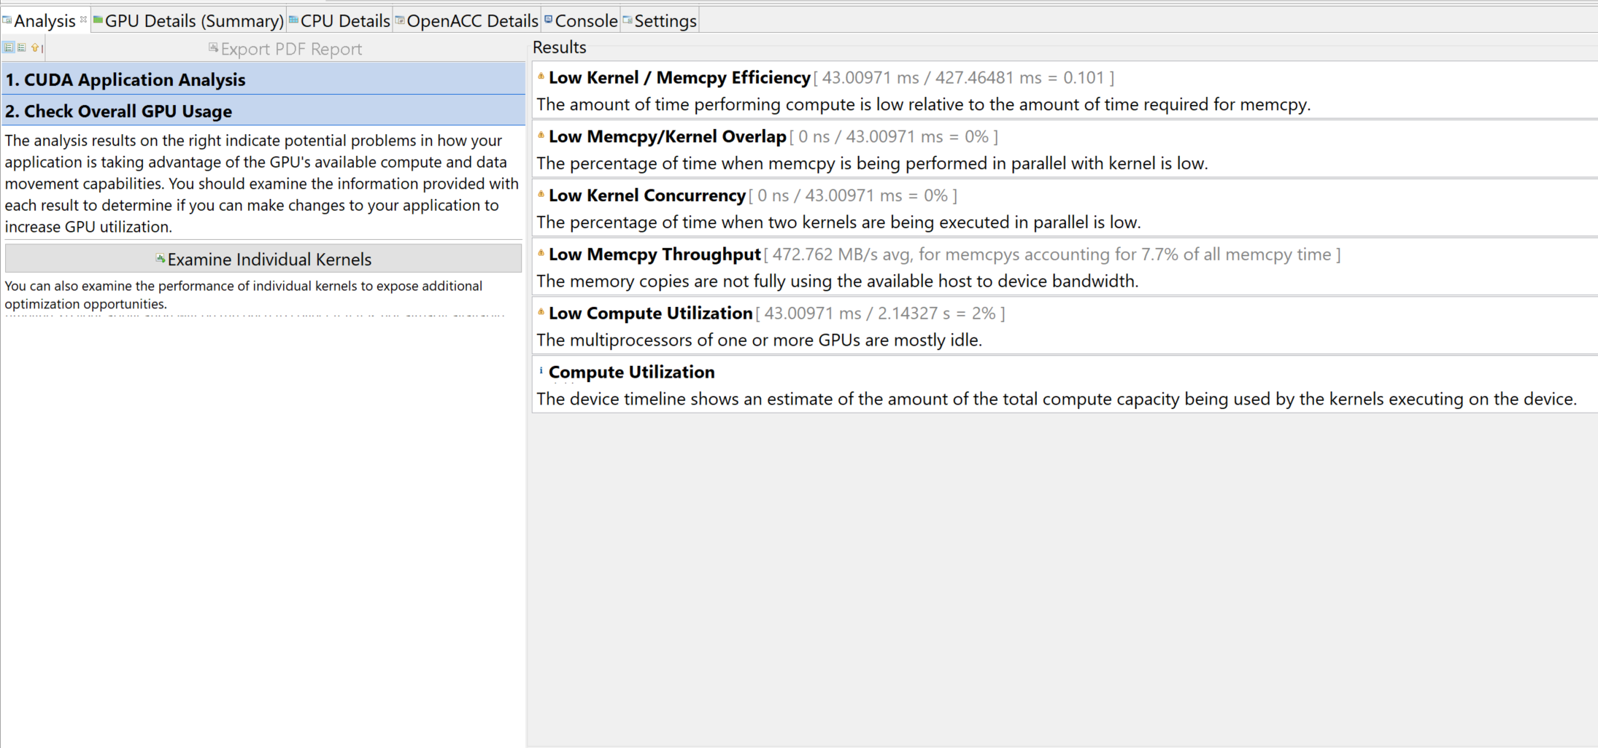
Examine GPU Usage - Results

Slide 48
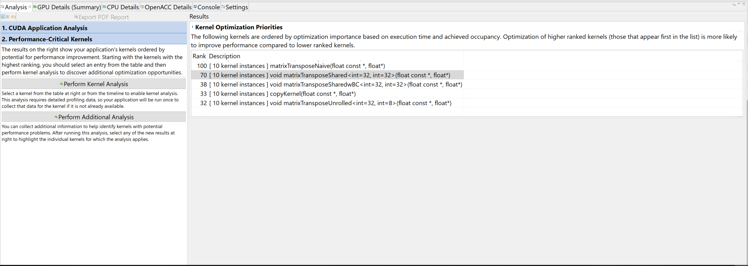
Guided Analysis
After GPU Usage, individual kernel can be analyzed.
Kernels with higher rank score (higher in the list)
can be more optimized

Slide 49
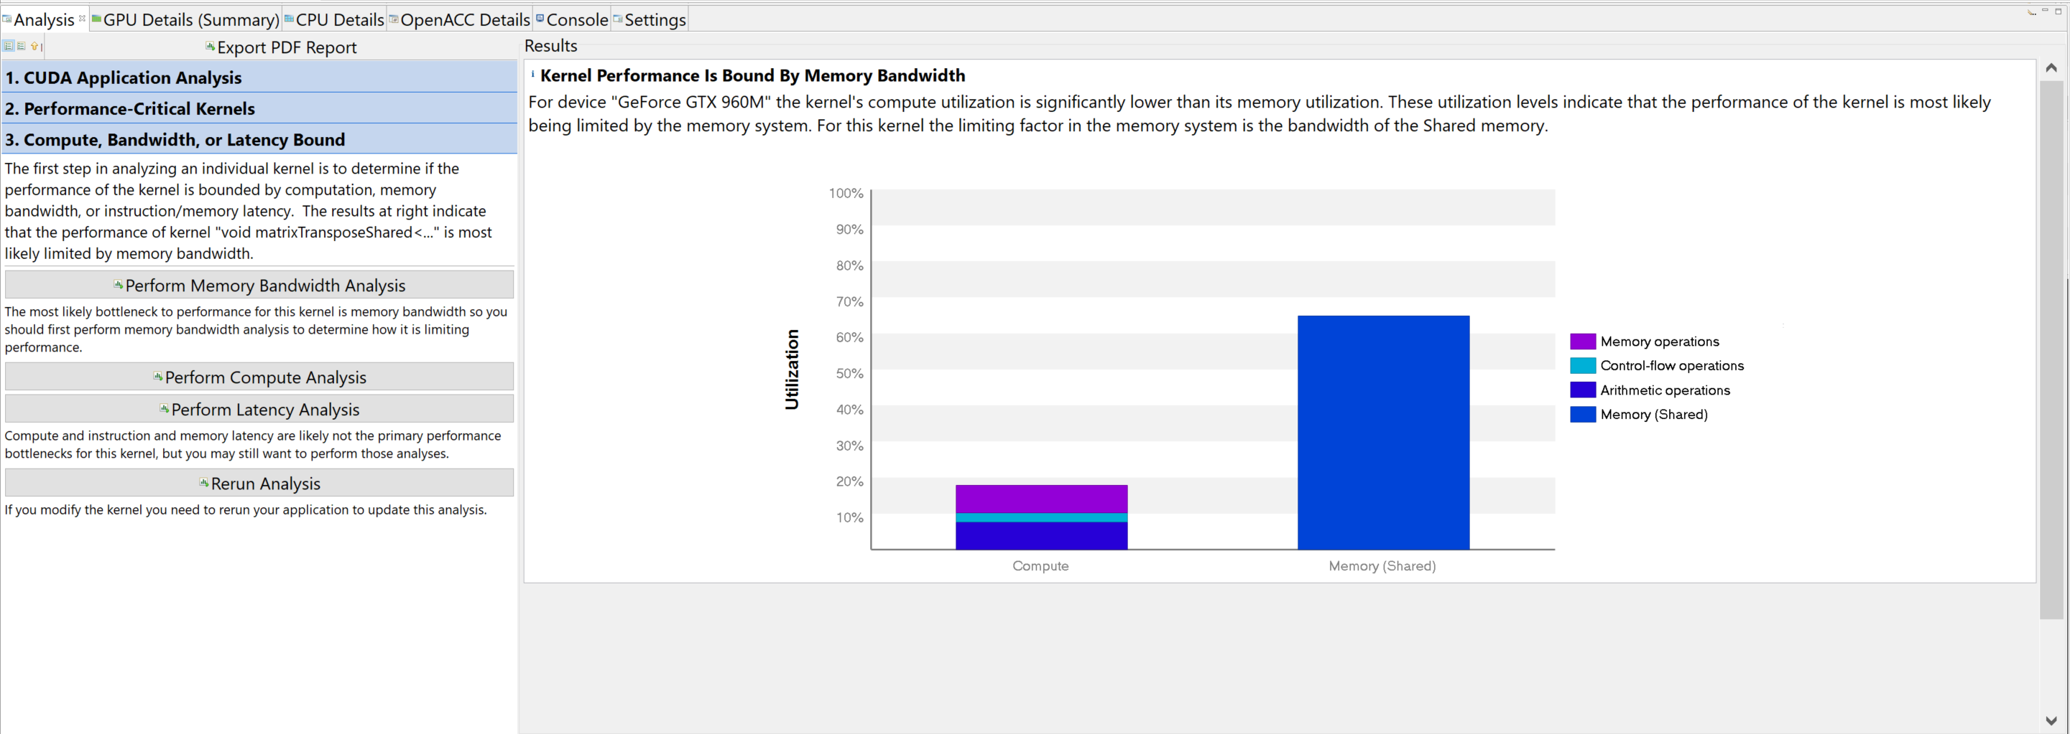
Perform Kernel Analysis - Results
Each analysis produces compute and other information
Can run additional, more specific analysis

Slide 50
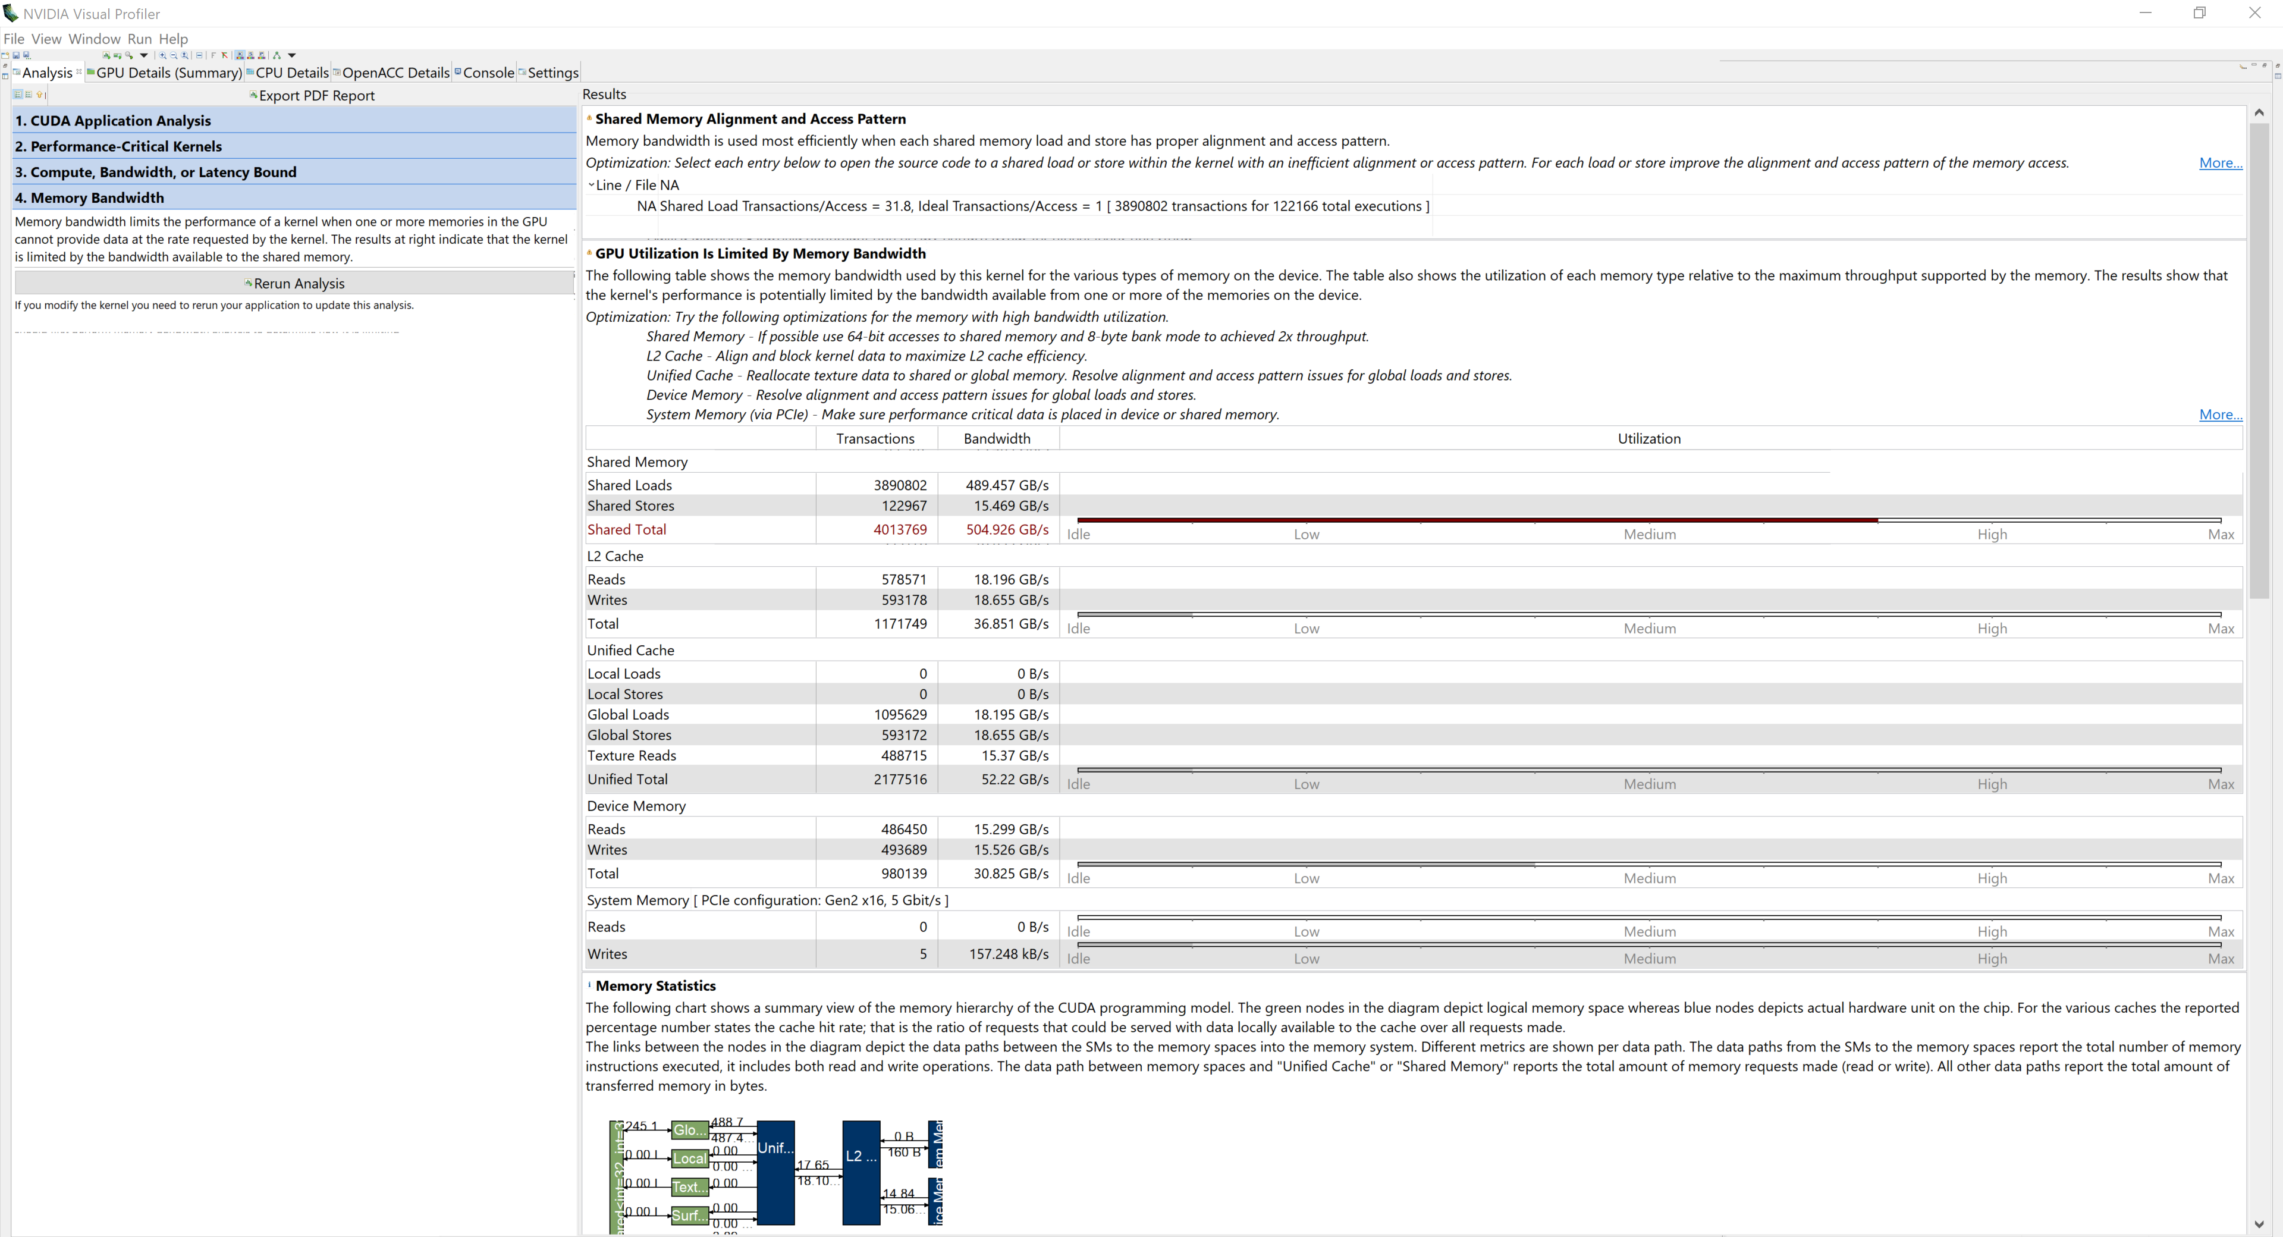
Memory Bandwidth Analysis - Results

Slide 51
Memory Bandwidth Analysis - Results

Slide 52
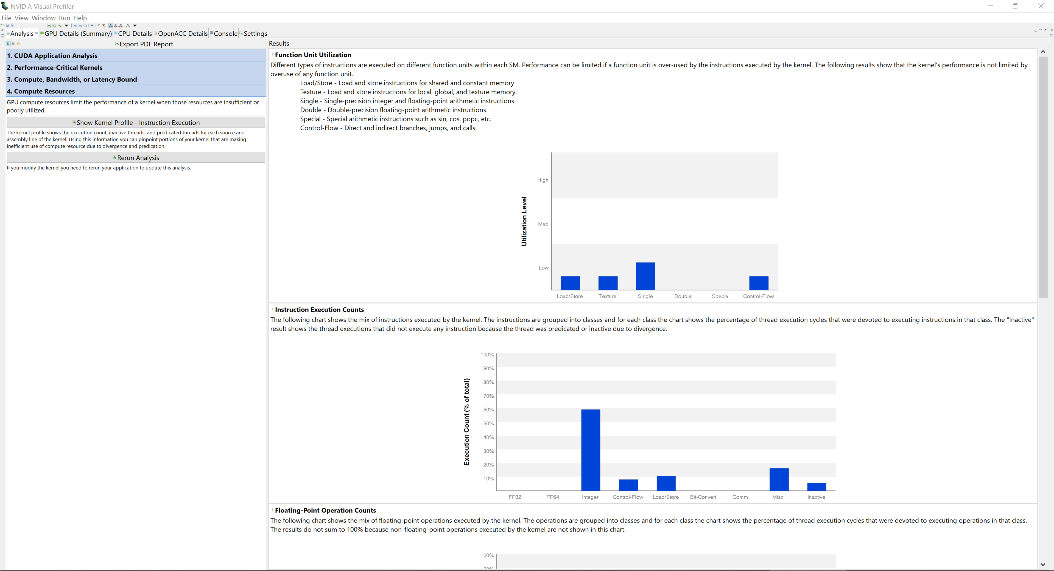
Compute Analysis Results

Slide 53
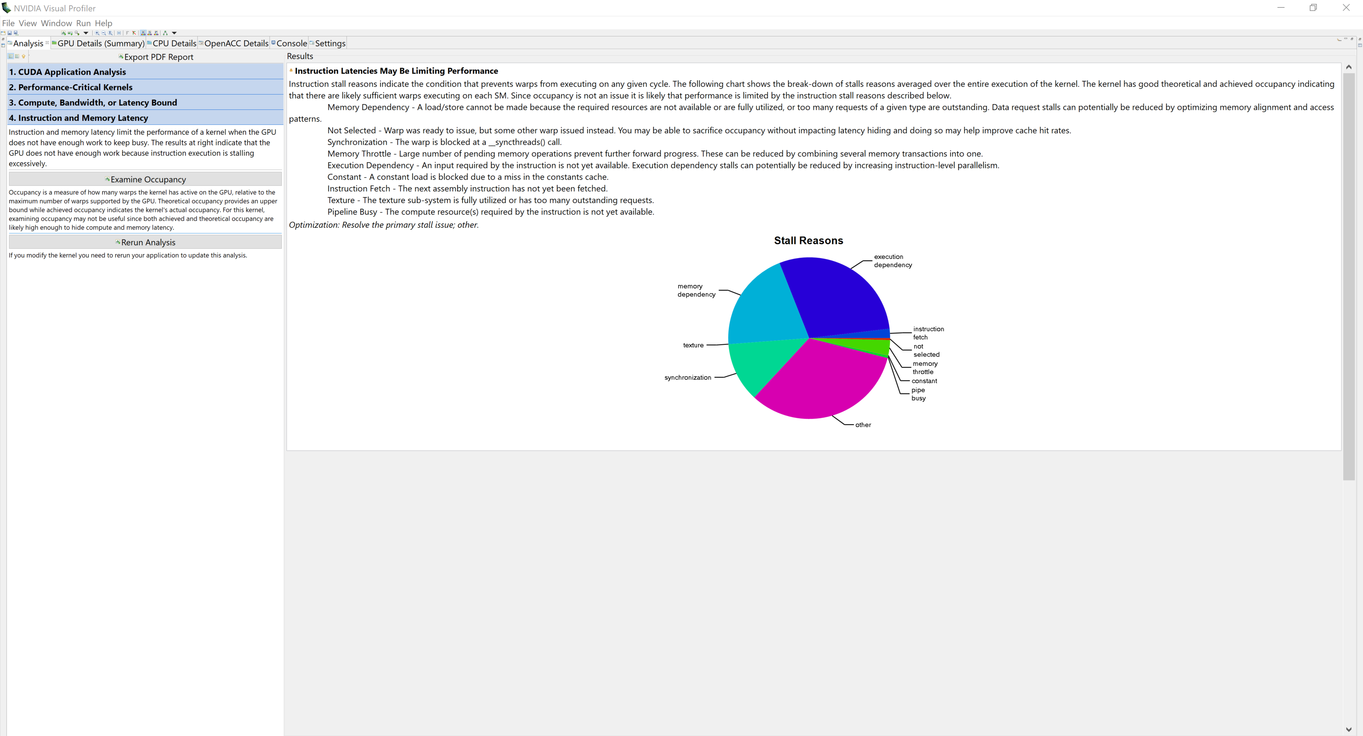
Latency Analysis - Results

Slide 54
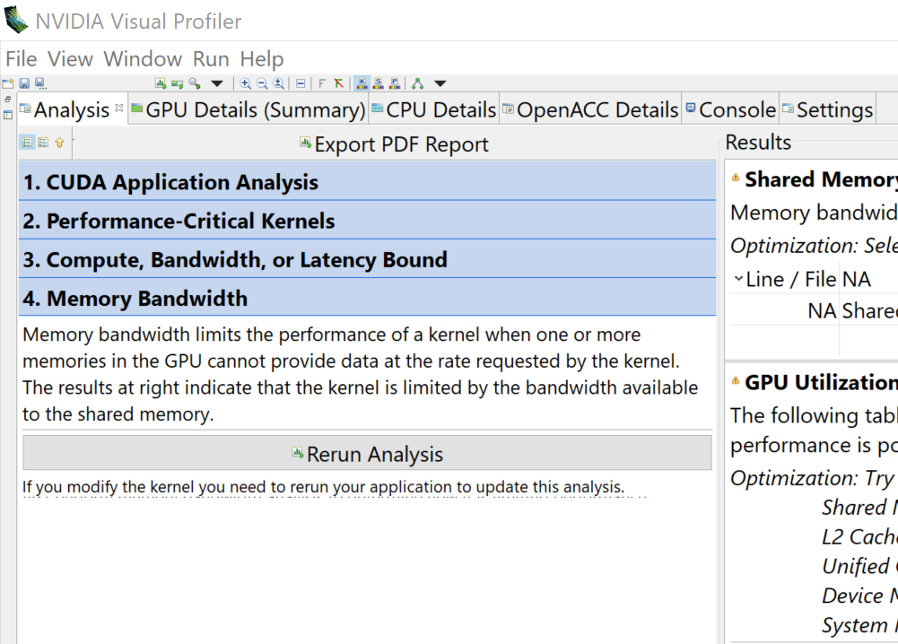
Go back and rerun other analysis
Click on any tab to go back and run other analysis

Slide 55
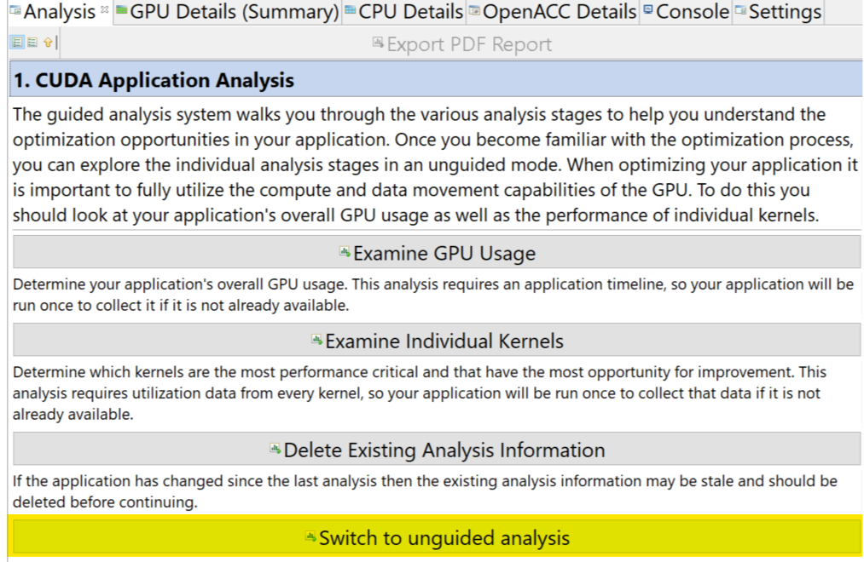
Unguided Analysis
Gives more low-level information that a developer can review

Slide 56
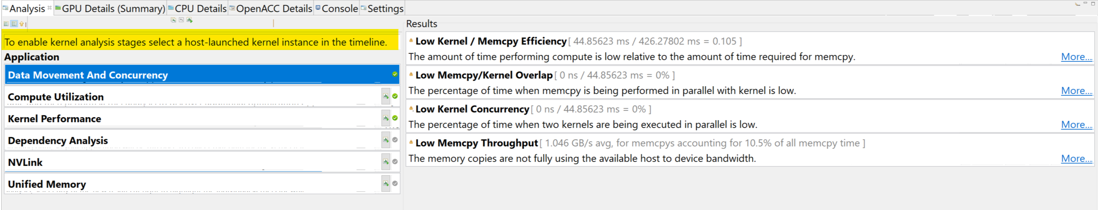
Unguided Analysis
Click a kernel on the timeline to see more information

Slide 57
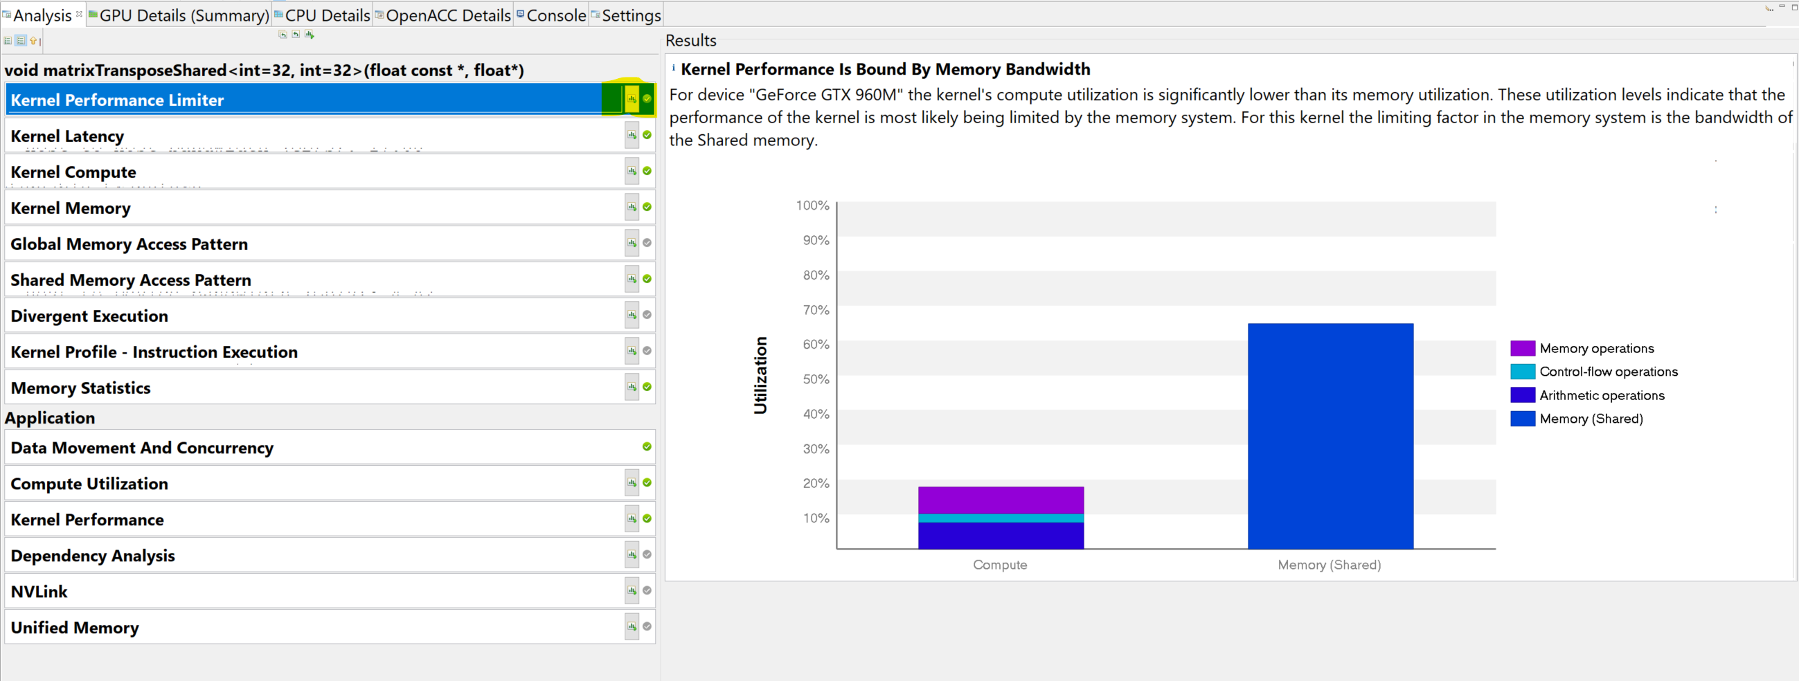
Unguided Analysis - Kernels
May need to click “Run Analysis”

Slide 58
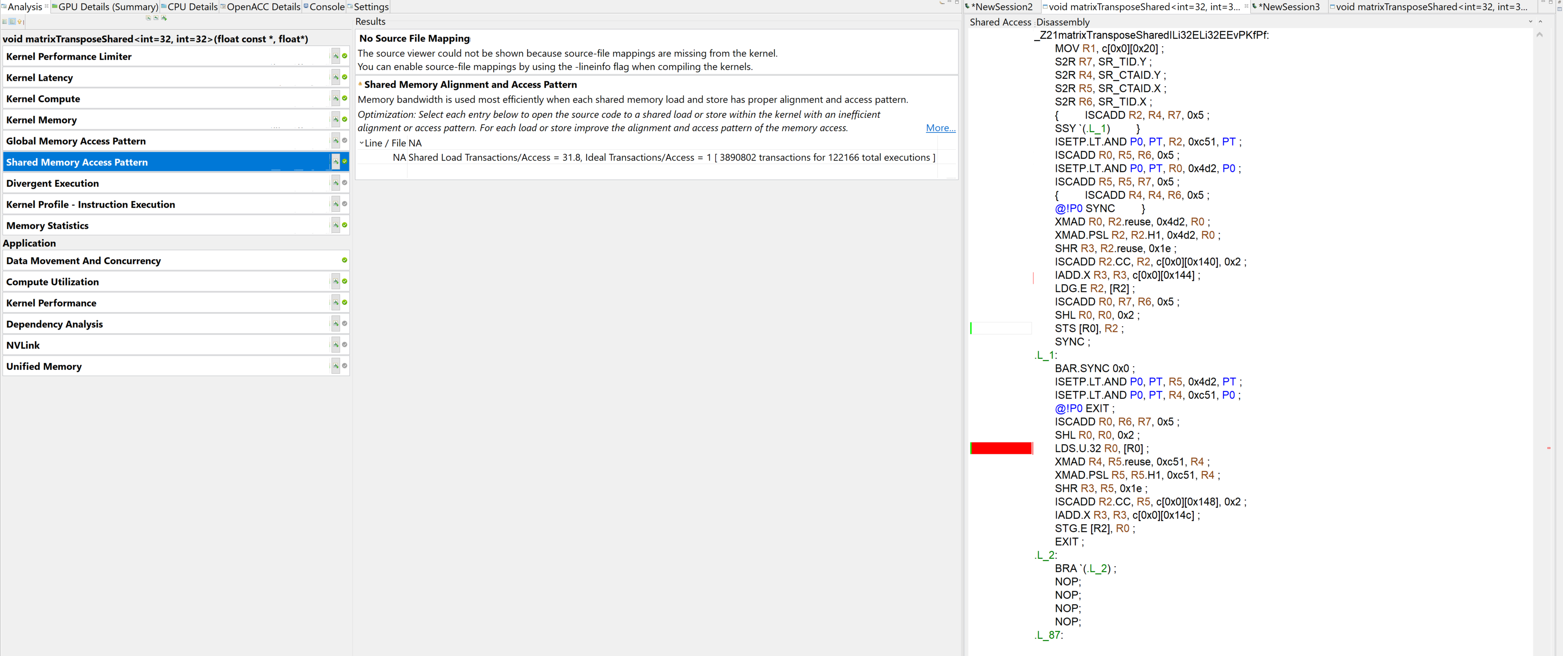
Unguided Analysis - Kernels

Slide 59


Unquided Analysis - Kernels
Offending instruction
LDS.U.32 R0 [R0]
Assembly instructions!!!

Slide 60

After adding -lineinfo

